Slide 1
Driving Faculty and Students to Online Success
By Melissa Batchelor and Mary Lou Watson

Slide 2
The Issues
2007 – 2010 Completion Rates defined as A, B, or C grade
Face-to-Face 85% completion
Online (including hybrid) 68% completion
17% Disparity
Notes:
Our concerns were strengthened by data comparing the successful completion rates (as defined by A, B, and C) between online students and those taking classes face-to-face (F2F).
Based on course completions, spring semesters, 2007 – 2010, the data illustrated that there was a 17% disparity between the two. The completion rate for F2F was 85% whereas online rates stood at 68%.

Slide 3
The Issues
Concerns over the quality of online course design, instruction, and student learning
Research in current online initiatives
The rubrics developed by University of Maryland Online FIPSE Project: Quality Matters and the Illinois Online Network Quality Online Course Initiative (QOCI)
Notes:
December, 2009 – concerns over the quality of online course design, instruction, and student learning led to a deep dive into the research on online course review initiatives, which led us to the University of Maryland’s Quality Matters, a rubric developed under a FIPSE grant
AT the same time, we received new guidelines from the Higher Learning Commission (HLC) that emphasized distance education

Slide 4
Expectations for HLC
Assure good instructional design in online courses;
Involve faculty in the instructional design process;
Encourage and ensure continuous improvement in online education;
Assess the learning of students who enroll in online courses to ensure they achieve the levels of performance that are expected of all students; and
Determine if the online courses were meeting quality design standards
Notes:
Knowing that we were beginning to prepare for re-accreditation in March of 2013, our Vice-President of Academic Affairs asked two experienced and respected online faculty to develop an online review rubric that would adhere to the expectations of HLC:
Assure good instructional design in online courses;
Involve faculty in the instructional design process;
Encourage and ensure continuous improvement in online education; and
Assess the learning of students who enroll in online courses to ensure they achieve the levels of performance that are expected of all students, and
Determine if the online courses were meeting quality design standards

Slide 5
Proposed Solutions
Review the design of all online and web-blended (hybrid) courses using a rubric developed by LC faculty
Offer a course for students that introduces and explains online learning
Develop a policy for student online course enrollment
Notes:
The rubric for assessing online course design was created and presented to both the College’s faculty association executive committee and a larger group of experienced online faculty seeding suggestions and ultimately approval.

Slide 6
Online Course Review
The L&C Checklist for Instructor Review of Online and Hybrid Course Design
Includes criteria from Quality Matters and QOCI
Adheres to the HLC expectations
The ultimate goal was
to support the process of a self-review of an online or web-blended course in order to maintain continuous quality improvement;
to enhance student learning;
to assure course standards contribute to the fulfillment of L&C’s mission statement.
Notes:
The rubric for assessing online course design was created and presented to both the College’s faculty association executive committee and a larger group of experienced online faculty seeding suggestions and ultimately approval.

Slide 7
Student Course
The Director of Technology Enhanced Learning develops an online orientation course for students interested in enrolling in an online/hybrid class.
September, 2010, LCCC 202, Introduction to Online Learning, is added to the winter/spring schedule of classes.
LCCC 202 is a two-week, non-credit, free online course that helps prepare students for online learning.
Notes:
On a parallel track, the College was also trying to improve student completions of online courses.
The Director of Technology Enhanced Learning developed an online course orientation for those students interested in enrolling in online/web-blended courses
September, 2010, LCCC 202, Introduction to Online Learning, was added to the winter/spring schedule of classes.
This is a two-week, non-credit, free courses that in the beginning, was mandated for all students wishing to enroll in online courses. Students who didn’t finish it within the two-week time frame, could re-enroll in another section and pick up where they left off.

Slide 9
Online Enrollment Policy for Students
The College researches LC student online course completion rates and finds that GPA matters.
GPA guidelines for enrollment are developed
Students must have a GPA of at least 2.3;
Students with a 2.3 and above must take LCCC 202 first (later amended to a GPA of 2.3 – 2.69; course recommended, but not required for < 2.7);
All new students must take LCCC 202;
A student who fails a particular online course may not retake it.
Notes:
Fall, 2010, back-to-back sessions of LCCC 202 were being offered.

Slide 10
Initial Online Review Timeline
June 2010 – Faculty begins to self-review the design of their courses using the Online Review Checklist.
August, 2010 and January, 2011 – In-service workshops are held.
February 2011 – Peer Support Team begins reviewing the courses.
March 2011 – TEL Director contacts online faculty with recommendations.
April 2011 – All 154 spring course reviews are complete.
Notes:
October, 2010 – the Vice-President of Academic Affairs emailed all online/web-blended faculty stating that all self-reviews must be completed by February 18, 2011 or their courses will not be listed in the Fall 2011 Schedule of Classes.
February, 2011 – working in teams of three, the Peer Support Team began the arduous process of reviewing all 154 courses.
March, 2011, the Director of Technology enhanced Learning emailed all online/web-blended faculty with a timeline for the review process, which included when they would receive recommendations for course design improvement and by when they would need to have their courses revised.
Email contained a schedule of hands-on workshops during which faculty could receive technical support when completing their revisions.
Throughout the spring semester, the Director was helped by two part-time TEL staff who provided assistance with these workshops.
April 1, 2011 – all reviews are complete and the TEL director because to share the feedback from the team. This was presented as one of two types of recommendations:
Required
Advisory (quality)

Slide 11
Initial Online Review Timeline
Spring, 2011 - EDTR 266, Implementing Blackboard Learn, a free Blackboard training course, is offered.
Trains faculty how to use the critical instructional components in Blackboard
April, 2011 - a progress report on the online course review process is made to the College Board of Trustees.
May, 2011 – new data shows positive results.

Slide 12
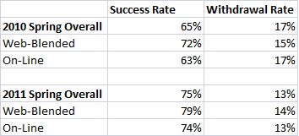
Comparison Spring 2010 to Spring 2011 Completion and Withdrawal Rates

Slide 13
Moving Forward
June, 2011 – the Online Review Checklist is revised and sent to the Peer Support Team.
July, 2011 – Deadline for the self-review of fall online courses
Fall, 2011 – the Peer Support Team becomes the Technology Enhanced Learning Committee (TELC).
August, 2011 – TELC meets for the first time.
Checklist revisions are approved.
Courses reviews will continue.
Notes:
Over the next few semesters, the TELC grew from nine to thirteen people who met once a month to discuss issues surrounding the online environment. Among other things, they implemented the following guidelines
Start here

Slide 14
The Online Review Process
Existing courses are reviewed on a three-year cycle.
New courses or existing courses with new instructors are reviewed on an as-needed basis.
Each September and January, the TEL director emails affected faculty, sends them the latest checklist and a timeline for the review.
A subcommittee of the TELC looks at the design of these courses and send recommendations to the TEL Director.
The TEL Director works with each to ensure that all revisions are complete.

Slide 15
Online Instructor Guidelines
Experienced instructors teaching a course for the first time are reviewed during the first semester the course is taught.
New online instructors must
Complete EDTR 266, Blackboard Training;
Design a complete course following the checklist guidelines and submit it for review.
Once the course is approved, it is added to the schedule.

Slide 16
Schedule for Review of New Online Classes for First-Time Online Instructors
If a class is to be taught in the | And because enrollment starts the previous | The course must be completed by the | Which allows the following months for reviews/revisions
Summer | March | End of previous Fall | Jan/Feb
Fall | March | End of previous Fall | Jan/Feb
Spring | November | July 30 of the previous year | Aug/Sept

Slide 17
A Culmination of All of Our Hard Work

Slide 18
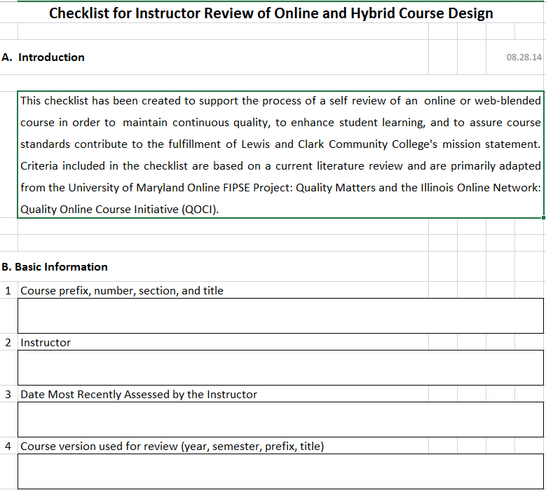
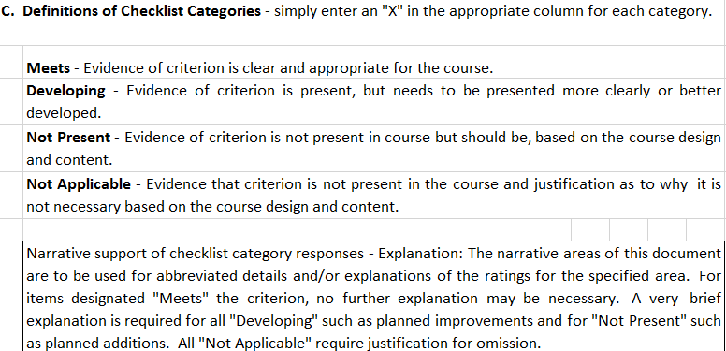
The Checklist

Slide 19
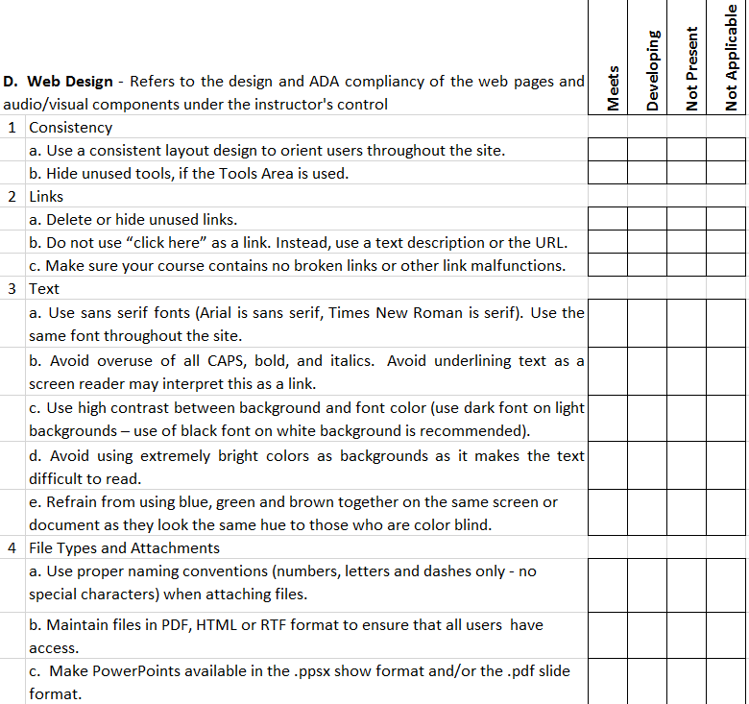
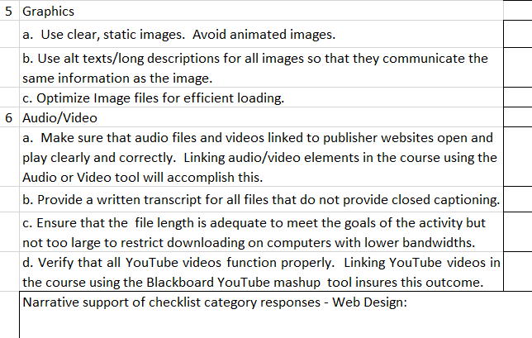
The checklist is continually revised as innovative practices emerge and Blackboard updates are introduced.

Slide 20
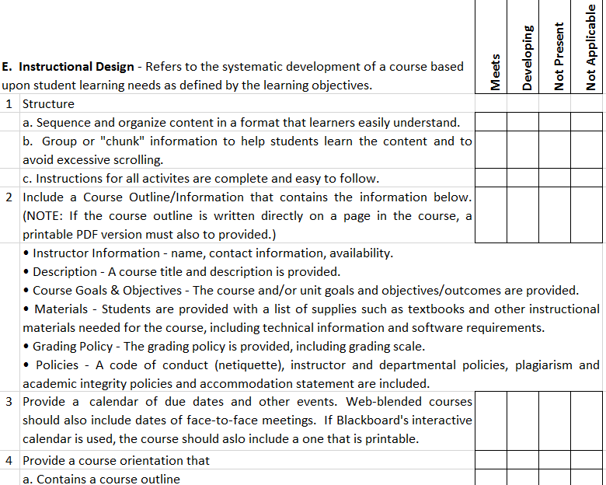

Slide 21
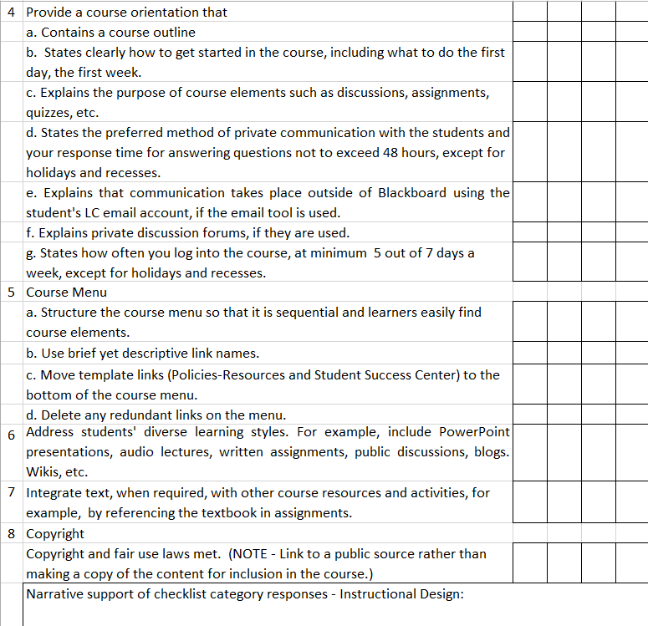

Slide 22
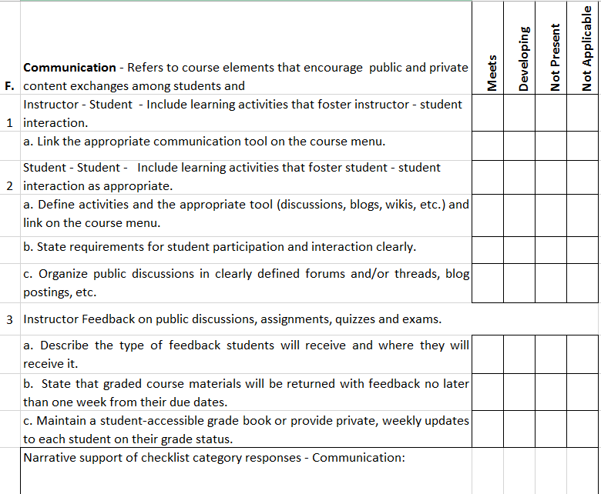

Slide 23
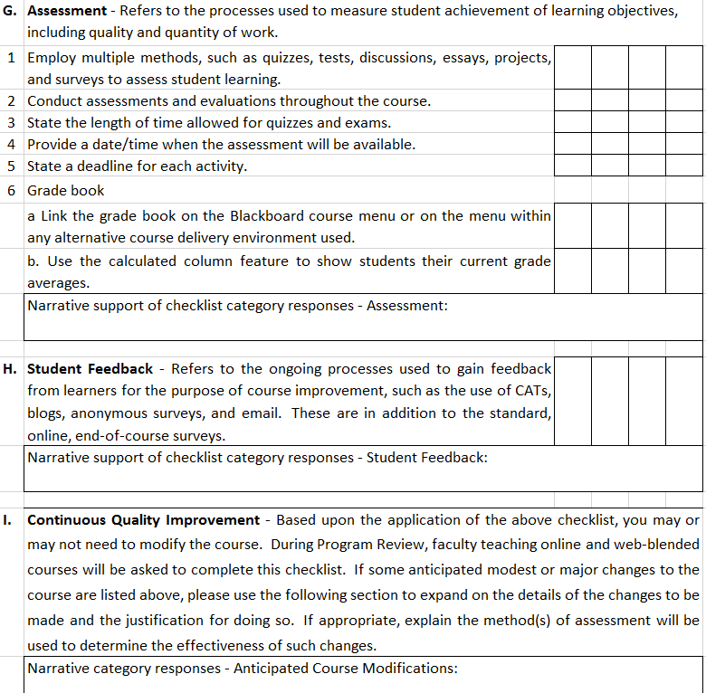

Slide 24
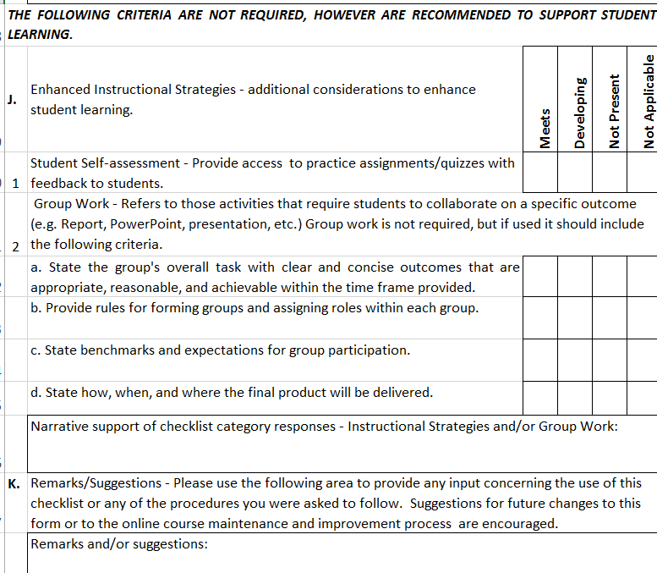

Slide 26
Contact Information
Dr. Melissa Batchelor, Coordinator of the Child Development and Education Program – mbatchel@lc.edu
Mary Lou Watson, Director of Technology Enhanced Learning – mlwatson@lc.edu

