Slide 1
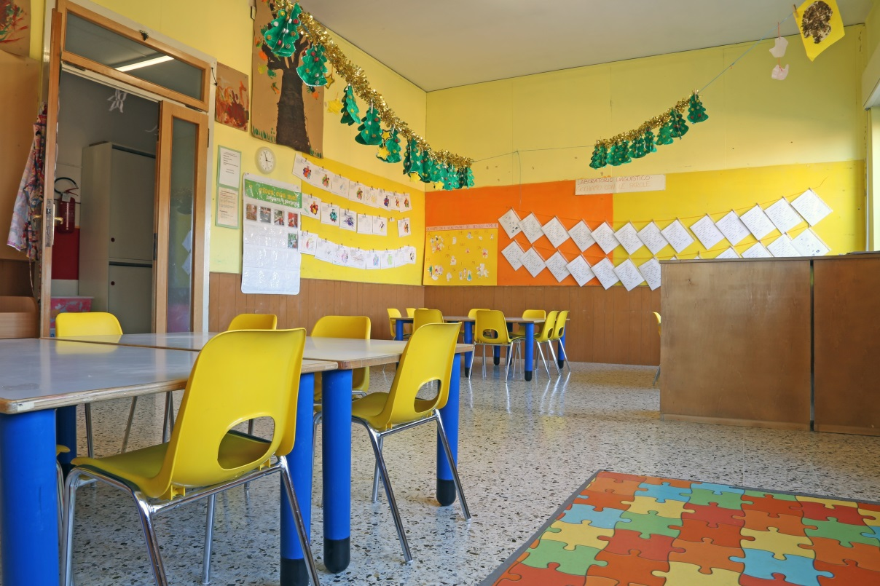
Performance Assessment
Early Childhood Education

Slide 2
Overview
Policy context
Aspects of program readiness
Using results
Discussion

Slide 3
Policy context
Highly effective educators

Slide 4
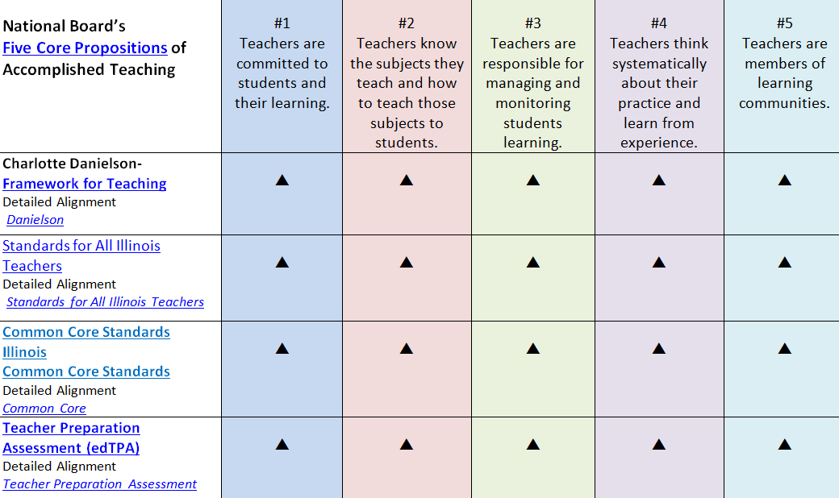
Aligning professional standards
Notes:
Source: http://nbrc.illinoisstate.edu/
Also ask your edTPA coordinator about detailed alignments produced by SCALE (Marzano, Danielson)

Slide 5
edTPA
Evidence of practice
FfT
Ongoing evaluation and development
NBCT
Evidence of practice
Reflection
Reflection
Reflection
Beginning teaching
Evidence of practice
Accomplished teaching
Highly Effective Educators
Superintendent
Principal
Teacher Leader

Slide 6
Core of Effective Beginning Teaching

Slide 7
Program readiness
Faculty knowledge
Candidate preparation
Candidate support

Slide 8
Faculty knowledge
15 constructs
Instructional Goal
Subject-specific pedagogy
Targeted student learning
Academic language

Slide 9
Early Childhood Education
Instructional goal
Support children’s language and literacy development through active and multimodal learning
Subject-specific pedagogy
Use interdisciplinary learning experiences to promote children’s development of language and literacy
Targeted student learning
Develop language and literacy
Academic language
Identify and support vocabulary development (appropriate sounds, words, phrases, sentences and paragraphs that children must use or create to engage in learning
Notes:
Focus on literacy development might seem narrow, but wonder if it’s not the essential academic target in ECE settings. Yes, play and centers are also important to practice . . .

Slide 10
Faculty knowledge
Learning in company
Dedicate time to unpack together
URLP document
Local evaluation training
edTPA National Academy
Official scoring
Apply with Pearson
Review local samples
Make new BFFs
Nothing like seeing what your own candidates do

Slide 11
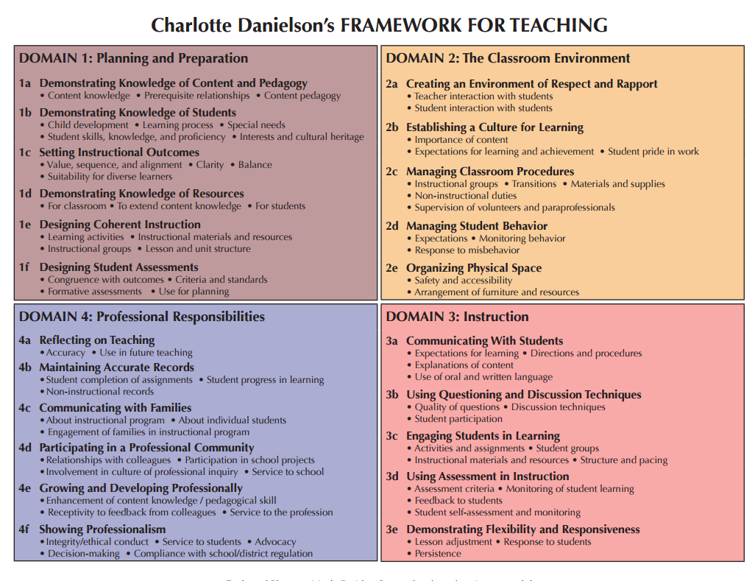
Faculty knowledge

Slide 12
Candidate preparation
Backwards mapping
Thoroughly introduced
Opportunities to practice and get feedback
Most technically difficult earlier
Structured supports

Slide 13
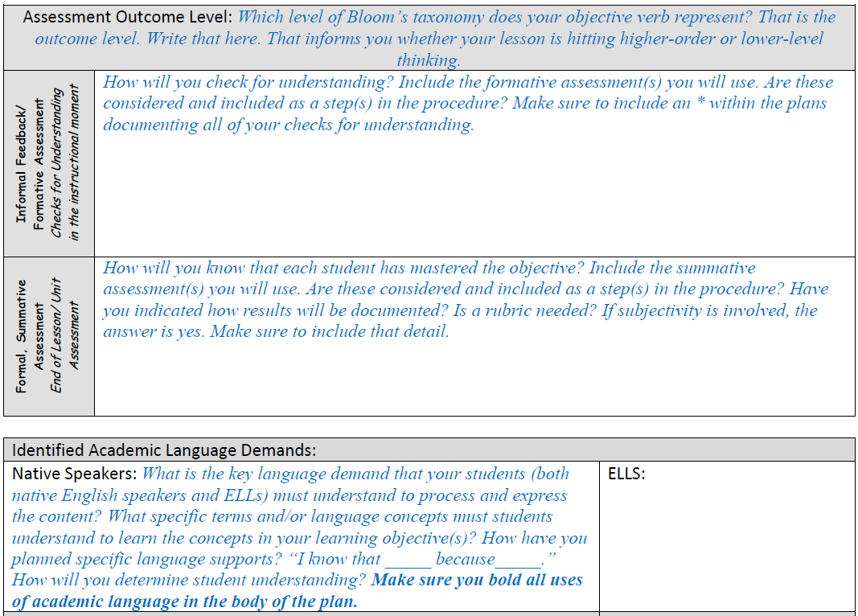
Cueing in lesson plan template

Slide 14
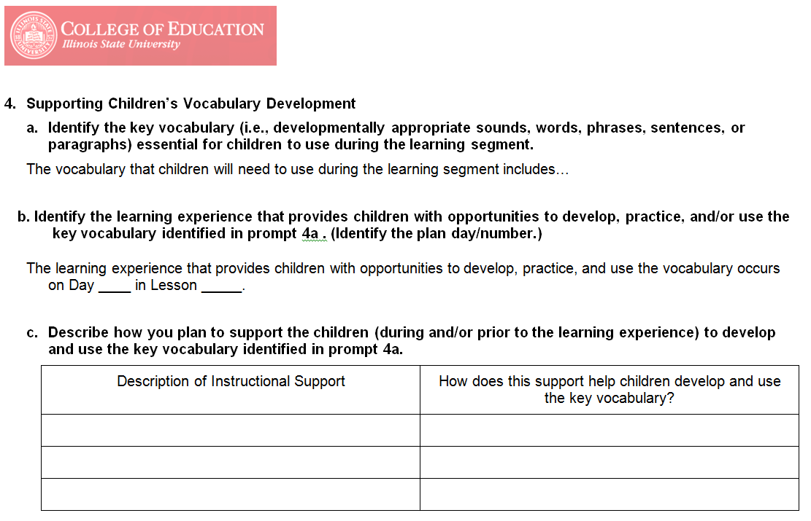
Thinking organizers

Slide 15
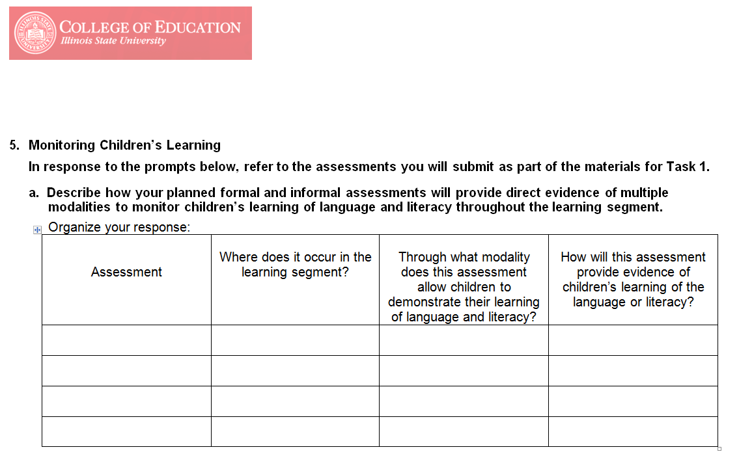
Thinking organizers

Slide 16
Academic language
key to children being able to participate in learning.
Practice identifying essential vocabulary, designing supports for children’s use of the vocabulary, and explaining why these supports will assist the children in using the vocabulary.

Slide 17
Candidate & supervisor support
Observation evidence collection
DOMAIN 3b: Using Questioning and Discussion Techniques
1.Questions of high cognitive challenge, formulated by both students and teacher
2. Questions with multiple correct answers or multiple approaches, even when there is a single correct response
3. Effective use of student responses and ideas
4. Discussion, with the teacher stepping out of the central, mediating role
5. Focus on the reasoning exhibited by students in discussion, both in give-and-take with the teacher and with their classmates
6. High levels of student participation in discussion

Slide 18
Candidate & supervisor support
Observation evidence collection
DOMAIN 3d: Using Assessment in Instruction
1.The teacher paying close attention to evidence of student understanding.
2. The teacher posing specifically created questions to elicit evidence of student understanding.
3. The teacher circulating to monitor student learning and to offer feedback.
4. Students assessing their own work against established criteria.

Slide 19
Candidate & supervisor support
Post-conferencing
Assessment: Consider these questions for the post conference:
How did you differentiate your feedback to students? Was your feedback based on your students’ varying levels of understanding of the content? How did you know whether or not the students understood the content to a point that they could use the content in new ways? (Instead of: What feedback did you provide? What formative assessments did you use?)
How did your feedback evidence respect for and caring for your students? (This gets at meaningful comments being used—not just “good job”—the respect is an outgrowth of high expectations) (Instead of: Did you use constructive feedback?)
What are the goals/targets you expect the students to meet? How do you know whether or not they have met those targets/goals? (Instead of: Did you assess your objectives?)
What opportunities did students have to develop and to determine the measurement of their understanding of the content? (Instead of: Are students involved in the development of formative assessments?)
How did you know whether students are ready to move to new understandings and content as a result of this lesson? (Instead of: What formative/summative assessments were used?)
What next steps of instruction and targeted support have you planned as a result of analyzing what students know and are able to do? (Instead of: What are your next steps?)

Slide 20
Discussion
Thank you!

