Slide 1
Higher Education Faculty Series: "Making the Illinois Early Learning and Development Standards Come Alive for Your Preservice Students"
Gaye Gronlund, M.A.
Early Childhood Education Consultant
Tucson, AZ & Traverse City, MI
gayegronlund@yahoo.com

Slide 2
Gaye Gronlund www.gayegronlund.com Resources available from www.redleafpress.org or www.naeyc.org
Planning for Play, Observation, and Learning in Preschool and Kindergarten
Developmentally Appropriate Play: Guiding Young Children to Higher Levels (with parent brochure, Why Children Play)
Developmentally Appropriate Play Stories Volume 1 (an interactive video program)
Make Early Learning Standards Come Alive 2nd edition: Connecting Your Practice and Curriculum to State Guidelines
Focused Observations 2nd edition: How to Observe Young Children for Assessment and Curriculum Planning (coauthor, Marlyn James)
Focused Portfolios: A Complete Assessment for the Young Child (coauthor, Bev Engel)
Early Learning Standards and Staff Development: Best Practices in the Face of Change (coauthor, Marlyn James)
Produced the CD-Rom accompanying Developmentally Appropriate Practice in Early Childhood Programs, 3rd Edition, NAEYC and the DVDs, “The New Developmentally Appropriate Practice”, “DAP and Intentionality” and “DAP and Play”

Slide 3
Key Points for Today’s Webinar
How best to introduce preservice students to the Illinois Early Learning and Development Standards (IELDS).
Weaving the IELDS into curriculum courses.
Weaving the IELDS into authentic assessment courses.
Linking the IELDS to the Common Core State Standards and clarifying their role in Illinois preschool programs.

Slide 4
Career and College Readiness
Illinois Learning Standards
(includes Common Core) Early Elementary through High School
Illinois Early Learning Standards for Kindergarten
(includes Common Core) Ages 5 - 6 Years
Illinois Early Learning and Development Standards Ages 3-5 Years
Aligned with Head Start Child Development & Early Learning Framework
Illinois Early Learning Guidelines
Birth to Age 3 Years
4
Notes:
4

Slide 5
The IELDS are NOT…
a curriculum
an assessment tool or developmental screening
an exhaustive resource of child development
a developmental checklist
Notes:
IELDS Misconceptions
Share: (Four bullets will appear as you click enter)
It is important to recognize and affirm what the IELDS are and are not.
IELDS are not a curriculum. The IELDS are to be integrated of a research based curriculum.
IELDS are not an assessment tool or developmental screening. There are other screening tools such as ASQ-3 or assessment systems such as GOLD available and serve this purpose.
IELDS are not an exhaustive resource of child development.
IELDS are not a developmental checklist.
5

Slide 6
IELDS Facts
The IELDS provide a cohesive analysis of children’s development with common expectations and common language for 3-5 year olds.
They are a source of useful information and direction to preschool teachers when they are:
determining appropriate expectations for preschoolers
planning for individual children’s needs
implementing a play-based curriculum
using authentic, observational assessment procedures
Notes:
IELDS FACTS Share:
The IELDS provide a cohesive analysis of children’s development with common expectations and common language for all early childhood professionals.
IELDS are a source of useful information and direction to preschool teachers when they are:
- determining appropriate expectations for preschoolers
- planning for individual children’s needs
- implementing a play-based curriculum
- and using authentic, observational assessment procedures
6

Slide 7
Therefore…
Teachers in preschool classrooms in Illinois will focus on the Illinois Early Learning & Development Standards.
Teachers in kindergarten classrooms will focus on the Common Core State Standards for the end of kindergarten.

Slide 8
You can make the standards come alive for your students by…
Familiarizing them with the IELDS document
Helping them see the connection between play-based preschool curriculum and standards – they can and do go together!
Clarifying how standards can fit with authentic, observational assessment processes

Slide 9
These sections make for great discussions
The Preface &
Introductory Letter
Purposes, Uses & Terminology
The Guiding Principles
How to Navigate Page
Notes:
9

Slide 10
There are 8 domains/sections
Language Arts
2. Mathematics
3. Science
4. Social Studies
5. Physical Development & Health
6. The Arts
7. English Language Learner Home Language Development
8. Social/Emotional Development

Slide 11
Every domain section begins with an illustrative story and an introduction to the domain. Again, great discussion material!

Slide 12
The Preschool Benchmarks are the Core of the IELDS
Notes:
PRESCHOOL BENCHMARKS
Share:
The Preschool Benchmarks are the core of the IELDS. The benchmarks drive curriculum, instruction, and assessment (throughout the day we will discuss how to incorporate the IELDS into curriculum and assessment).
The Preschool Benchmarks provide teachers with specific ways that preschool children demonstrate learning standards.
The benchmarks are unique to preschool children.
A Summary Benchmark Index is provided beginning on page 160 in the IELDS for easy reference.
Direct participants:
To page 160 in the IELDS where the Summary Benchmark Index is located in the IELDS document. (Activity continues on next slide).
12

Slide 13
And, each benchmark page contains 6 elements:
Domain
Preschool
Benchmarks
Goal
Example
Performance
Descriptors
Learning
Standards
Common Core
State Standards
Alignment

Slide 14
Identify the domain
Find the page on which the benchmark appears
Look at the other benchmarks on that page

Slide 15
What domain best matches each of the following benchmarks?
#1. Identify body parts and their functions.
#2. Sort, order, compare, and describe objects according to characteristics or attribute(s).
#3. Exhibit eagerness and curiosity as a learner.
#4. With teacher assistance, recognize and match words that rhyme.
#5. Describe or respond to their own creative work or the creative work of others.
#6. Experiment with changes in matter when combined with other substances.
#7. Describe some common jobs and what is needed to perform those jobs.
#8. Participate in group projects or units of study designed to learn about a topic of interest.
#9. Informally solve simple mathematical problems presented in a meaningful context.
#10. CHALLENGE: Where would you find a benchmark about a child knowing his/her colors?
Notes:
SCAVENGER HUNT ACTIVITY continued…
Handout #4
This slide is of the handout #4 which the participants have been provided.
15

Slide 16
List of Benchmarks for Scavenger Hunt with correct domains, numbers, and pages
#1. Identify body parts and their functions. Physical Development and Health 23.A.ECa page 110
#2. Sort, order, compare, and describe objects according to characteristics or attribute(s). Mathematics 8.A.ECa page 52
#3. Exhibit eagerness and curiosity as a learner. Social/Emotional Development 30.C.ECa page 137
#4. With teacher assistance, recognize and match words that rhyme. Language Arts 4.C.ECb page 35
#5. Describe or respond to their own creative work or the creative work of others. The Arts 25.B.ECa page 121
#6. Experiment with changes in matter when combined with other substances. Science 12.C.ECb page 66
#7. Describe some common jobs and what is needed to perform those jobs. Social Studies 15.A.ECa page 82
#8. Participate in group projects or units of study designed to learn about a topic of interest. Language Arts 5.C.ECa page 39
#9. Informally solve simple mathematical problems presented in a meaningful context. Mathematics 6.B.ECd page 46
#10. CHALLENGE: Where would you find a benchmark about a child knowing his/her colors? Mathematics 8.A.ECa sorting & comparing by attribute; 8.A.Ecb simple patterns (page 52); Language Arts 1.E.ECb curiosity and interest in new words; 1.E.ECc With teacher assistance, use new words (page 26)
Notes:
16

Slide 17
The Example Performance Descriptors
Describe small steps of progress toward preschool benchmarks
Serve as a guide for teachers,
not as an assessment tool
There are three levels of performance descriptors in the IELDS: Exploring, Developing, and Building
Notes:
EXAMPLE PERFORMANCE DESCRIPTORS
Share: (three bullets fly in at the click of the mouse)
The example performance descriptors are provided in the IELDS to give examples that describe small steps of progress that children may demonstrate as they work toward preschool benchmarks. They are not intended to replace the IELDS nor are they all-inclusive. They are a resource to enable teachers to better recognize age-appropriate guidelines and expectations for preschool children.
The performance descriptors serve as a guide for teachers, not as an assessment tool.
The child does not have to master or perform every descriptor to show mastery of the preschool benchmark.
There are three levels of performance descriptors in the IELDS: Exploring, Developing, and Building. The child may demonstrate his or her capabilities related to a specific preschool benchmark in a different way than is described in the performance descriptors.
17

Slide 18
Exploring | Developing | Building
Choose one type of writing material to engage in making marks or scribbles identified as a name. | Choose one or two types of writing materials (e.g., markers, pencils) to engage in making letterlike forms identified as a name. | Use a variety of writing materials (e.g., markers, pencils, crayons, chalk) to attempt to write own name and/or the names of friends and family members.
Make marks or scribbles and identify as writing in play activities, such as developing a grocery list during dramatic play or a sign for a block construction. | Make letterlike forms and identify as writing in play activities such as developing a grocery list during dramatic play or a sign for a block construction. | Make letters or words in play activities, such as developing a grocery list during dramatic play or a sign for a block construction.
With teacher assistance, make marks or scribbles to represent own name on sign-up charts, drawings, and other pieces of work. | With teacher assistance, make letterlike forms to represent own name on sign-up charts, drawings, and other pieces of work. | With teacher assistance, write increasingly recognizable letters of own name on sign-up charts, drawings, and other pieces of work.
If available, show interest in letters on an electronic keyboard (e.g., computer, iPad). | If available, show interest in letters in own name on an electronic keyboard (e.g., computer, iPad). | If available, and with teacher assistance, locate and type letters in own name on an electronic keyboard (e.g., computer, iPad).
18
Notes:
18

Slide 19
Exploring | Developing | Building
Combine items to create a new number (e.g., combine two blocks with a friend’s two blocks and say, “Now we have four.”) | Separate items from a set (e.g., with a set of three cups, takes one away and say, “Now we have two.”) | Recognize that combining sets always results in “more” and separating sets always results in “less.”
Count out two objects correctly (e.g., count two crackers on plate at snack time). | Count out three and four objects correctly (e.g., count four blocks in a block tower). | Count out five objects correctly (e.g., count five children in a small group).
Solve simple math problems (e.g., know that if one child is added to the group that makes one more). | Solve simple math problems (e.g., know that if one chair is taken away from the table that makes less). | Solve simple math problems (e.g., know that if one orange is taken away from a group of five, there are four oranges left).
Divide a set of two to four objects between self and a friend evenly. | Divide a set of six to eight objects between self and a friend evenly. | Divide a set of ten crackers between self and a friend evenly.
19
Notes:
19

Slide 20
You may want to consider…
Cutting the charts apart into “puzzles” to be reassembled in the correct order.
Having students observe children in action and relate the child’s performance to one of the levels (Exploring, Developing, Building) for specific benchmarks.
Using video clips for observations as above.

Slide 21
Each book comes with a CD-ROM with 19 video clips for practicing observations www.redleafpress.org

Slide 22
The Illinois State Board of Education Recommends the Following Regarding Curriculum
The IELDS can be embedded into
every aspect of the preschool day:
-in daily routines
-in engaging & purposeful
play
-in teacher-led large and small
group experiences
Notes:
22

Slide 23
What is curriculum in a preschool or kindergarten classroom?
Notes:
23

Slide 24
“Curriculum cannot be limited to a box, a book, or a set of materials. It’s a dynamic process of
implementing plans and observing what happens.”
(page 14)
“Curriculum is everything that goes on in a program from the moment a child arrives until she leaves. Teachers plan, implement, observe, reflect, and make adjustments based on individual children’s needs and the needs of the group.” (page 31)
Planning for Play, Observation, and Learning in Preschool and Kindergarten
Gaye Gronlund 2013
www.redleafpress.org
Notes:
24

Slide 25
Teachers integrate the standards
throughout
the day:
in daily routines,
in play and exploration,
and in large and small
group times.

Slide 26
Support for the importance of play
Educators
Pediatricians
Physical Health Advocates
Mental Health Experts
Evolutionary Biologists
Brain Researchers

Slide 27
NPR Report about Play 8-6-14
Through play, children develop brain capacity for problem-solving.
In play, social skills are honed and refined.
3rd graders with more successful social skills had higher academic achievement in 8th grade

Slide 28
Additional Resources about the Importance of Play
Play: How It Shapes the Brain, Opens the Imagination, and Invigorates the Soul by Stuart Brown, M.D.
Play = Learning: How Play Motivates and Enhances Children’s Cognitive and Social-Emotional Growth by Dorothy G. Singer, Roberta Michnick Golinkoff, and Kathy Hirsh-Pasek.
The Power of Play: How Spontaneous, Imaginative Activities Lead to Happier, Healthier Children by David Elkind, Ph.D.
Developmentally Appropriate Play: Guiding Young Children to a Higher Level by Gaye Gronlund.

Slide 29
Lesson Planning with the IELDS
Teachers can identify benchmarks as goals for each of their play and learning areas
They may choose three to five benchmarks a week that they are focusing on in all areas
Or, they may identify specific ones for each play and learning area
Teachers can incorporate benchmarks into daily routines and transitions
Teachers can plan for benchmarks as goals in teacher-led small and large group experiences
Notes:
LESSON PLANNING
Share:
The IELDS Preschool Benchmarks should be written on your lesson plans for play and learning areas, for daily routines and transitions, and for teacher-led small and large group experiences.
If you are using an observational assessment tool that has been aligned with the IELDS, you can use the indicators or benchmarks from the observational tool instead.
29

Slide 33
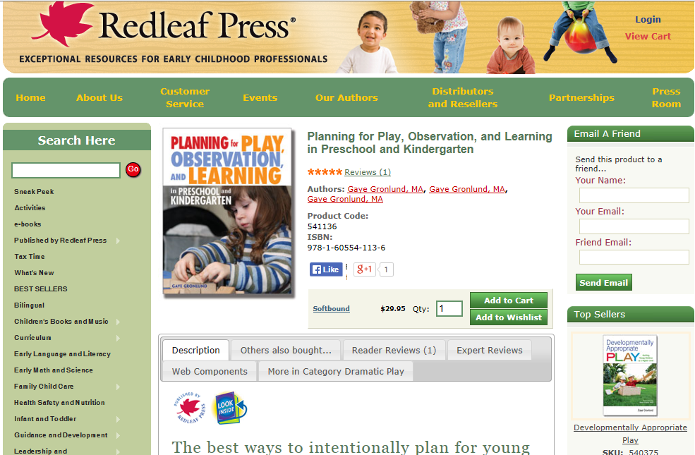
http://www.redleafpress.org/Planning-for-Play-Observation-and-Learning-in-Preschool-and-Kindergarten-P794.aspx

Slide 35
You may want to consider…
Having them identify benchmarks in multiple domains for play areas
Assign a play area (i.e., blocks, dramatic play, etc.) to a small group
Ask them to choose at least 4 domains and identify benchmarks in the IELDS that could be addressed in that play area
They can write their benchmarks on chart paper and post around the room

Slide 36
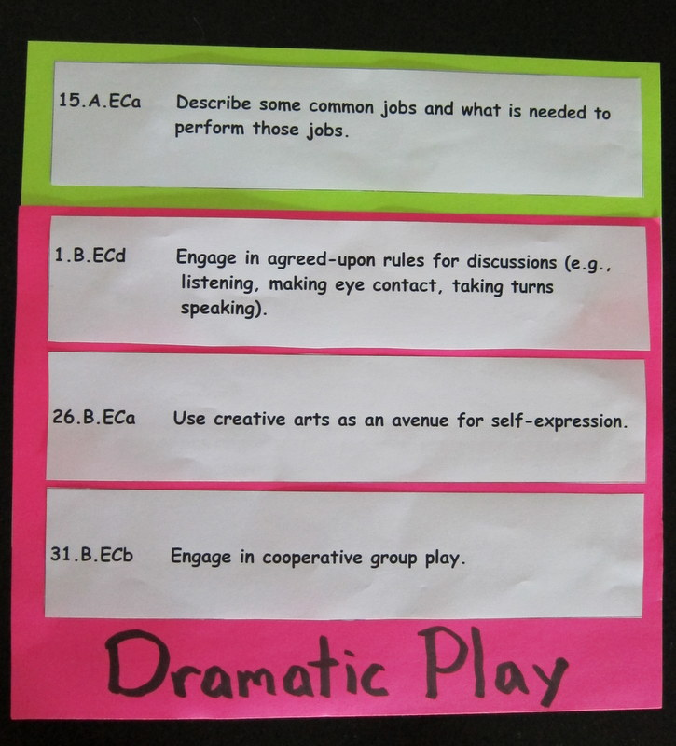
Teachers can make signs for
play areas with the benchmarks affixed with
Velcro so that they can change them as they address different ones in their lesson plans.
36
Notes:
SIGNS DISPLAYING BENCHMARKS
Handout #11
Share:
Here’s an idea for embedding the IELDS Preschool Benchmarks into your play areas. Consider making signs for your play areas with the benchmarks affixed with Velcro. Why Velcro? So that you can change them as you address different ones in your lesson plans.
In this design the benchmark that is in the lime green portion at the top is the primary focus for that week (or for a few weeks) and is written on the lesson plan. The others are additional benchmarks that can be addressed in that play area as well.
You change out the benchmarks when you see that the children have met them, or you think they are too challenging, or you determine it’s time for a change.
In Handout #11, you have been provided with a full set of the IELDS Preschool Benchmarks in suitable size for printing on cardstock or paper, laminating, cutting apart and affixing to signs in your play areas with Velcro.
36

Slide 37
What standards or goals could be embedded into these daily routines?
Arrival/Departure
Snacks/Meals
Outdoor Time?
Transitions

Slide 38
When Planning for Small Group Times, Child Engagement is the Overarching Goal
Standards can be embedded in small and large group experiences.

Slide 39
Small Group Work May Include:
Play with teacher support and guidance
(a board game, puzzles or manipulatives, sensory exploration or dramatic play)
Science experiments, cooking activities, or art activities that require adult supervision
Project work related to an interest of the children or an upcoming field trip
or Skill Work
The activities planned are broad enough so that each child can
participate and be successful at his or her own level.
The activities are deep enough to engage children
for ten to fifteen minutes.

Slide 40
You may want to consider…
Having your students plan for hands-on, engaging small group activities that address standards.
i.e., the pompom activities on the next slide

Slide 41
Pompom Activities
#1: Organize the pompoms from smallest to largest
#2: Do the Pompom Grab – try to grab seven without looking. Then, count to see how you did!
#3: Measure a variety of different objects with pompoms.
#4: Sort the pompoms on a sorting graph.
The ideas above and on the following pages
come from Math in Minutes: Easy Activities
For Children Ages 4-8
by Sharon MacDonald
Gryphon House
www.ghbooks.com

Slide 42
When Planning for Large Group Times, Child Engagement is the Overarching Goal
Standards can be embedded in small and large group experiences.

Slide 43
Planning Effective Large Group Times
Call children together through ritual and routine.
Move from more active to more passive activities.
Start with dancing, movement, standing songs
or chants
Move to sitting down and fingerplays, fine motor activities,
and quiet
If children settle down, choose from the following:
Take attendance
Read or act out a story
Demonstrate something
Introduce plans for the day and dismiss children as
as they make choices
Keep the group time going as long as children
are interested and engaged.
Have a routine for dismissing to
the next activity.

Slide 44
The Illinois State Board of Education Recommends the Following Regarding Assessment
The Illinois Early Learning & Development Standards (IELDS) Preschool Benchmarks are the criteria that can be used for authentic, observational assessment of preschool children’s learning, growth, and development.
Notes:
44

Slide 45
In addition, the Illinois State Board of Education Recommends…
As long as a research based, authentic, observational assessment tool is aligned with the IELDS, it may be used in conjunction with them.
The standards themselves are NOT an assessment.
Notes:
45

Slide 46
Assessing Children’s Progress Towards Developmental Expectations
Authentically, authentically, authentically!
By gathering information through observation and work sampling
By evaluating that information using the Early Learning and Development Standards or the Common Core State Standards as the reference by which the child’s accomplishments are measured

Slide 47
Standards provide a target, a reasonable expectation
for performance for typically developing children
Teachers, then, observe and assess where each child is
in relation to that target, that reasonable expectation
Every child has strengths
and weaknesses In various domains,
skills, and competencies.

Slide 48
Therefore, assessment procedures include…
Teachers observing children and documenting what they do through:
Checklists
Portfolios
Work samples
Photographs
Child-interviews and self-assessments
Summaries of children’s accomplishments, progress, and plans for next steps

Slide 49
You may want to consider…
Having students check out the alignments the publishers of the assessment tools have done in relation to the IELDS.
Having students observe children in action and relate the child’s performance to items on an authentic assessment tool that has been aligned to the IELDS.
Use video clips for observations as above.

Slide 50
You can also find video clips on You Tube that may be helpful.

Slide 51
Common Core Misconceptions
Entering kindergartners should be meeting the kindergarten expectations. (Truth: they are end of kindergarten expectations.)
Every child will be expected to achieve every standard. (Truth: the standards set reasonable targets for children’s performance in kindergarten.)
The standards are forcing teaching practices to be changed so that play, exploration, and hands-on learning are replaced with teacher-led lessons focusing on isolated and discreet skills in the standards. (Truth: the CSS do not advocate any kind of teaching practices or curricular approaches.)
Notes:
IELDS Misconceptions
Share: (Four bullets will appear as you click enter)
It is important to recognize and affirm what the IELDS are and are not.
IELDS are not a curriculum. The IELDS are to be integrated of a research based curriculum.
IELDS are not an assessment tool or developmental screening. There are other screening tools such as ASQ-3 or assessment systems such as GOLD available and serve this purpose.
IELDS are not an exhaustive resource of child development.
IELDS are not a developmental checklist.
51

Slide 52
Common Core Facts
Provide students, parents, and teachers with a clear understanding of what students are expected to learn by the end of every grade level
Stress not only procedural skills, but also conceptual understanding and higher order thinking – children are expected to ask questions and pose problems
There are multiple ways that students can represent what they know and understand
The Illinois Early Learning and Development Standards (IELDS) are aligned with the Common Core State Standards for Kindergarten in Language Arts and Mathematics
Notes:
PURPOSES OF COMMON CORE STANDARDS
Share: (Three bullets will fly in as you press enter)
The Common Core standards provide students, parents, and teachers with a clear understanding of what students are expected to learn at every grade level, and as such, serve as a roadmap to quality education.
The standards provide consistent learning goals for all students – regardless of where they live – so that when children move from one state to another, they will stay on track in school.
The standards stress not only procedural skills, but also conceptual understanding to make sure students are learning and absorbing the critical information they need to succeed at higher levels.
Refer participants interested in learning more about the CCSS to the following website: http://www.isbe.net/common_core/
52

Slide 53
The Illinois Early Learning and Development Standards (IELDS) are aligned with the Common Core State Standards for Kindergarten in Language Arts and Mathematics
Notes:
53

Slide 54
Therefore…
Teachers in preschool classrooms in Illinois will focus on the Illinois Early Learning & Development Standards.
Teachers in kindergarten classrooms will focus on the Common Core State Standards for the end of kindergarten.

Slide 55
To review…
The Illinois Early Learning and Development Standards can be integrated into many courses for preservice teachers.
Students can explore ways to incorporate standards in play, daily routines, and group times

Slide 56
Early childhood faculty can use the IELDS to better explain play-based curriculum and authentic assessment practices.
And, can clarify the appropriate use of the IELDS and the Common Core State Standards for Kindergarten.

