Slide 1
The Early Childhood Educator Preparation Innovation Grants: Lessons from Initial Implementation
Gateways to Opportunity Higher Education Forum
April 10, 2015
Eric Lichtenberger
Brenda Klostermann
Dan Duffy

Slide 2
Illinois Education Research Council
Our Mission
To provide objective and reliable evidence for Illinois P-20 education policy making and program development.
Ensuring Research-Informed Education Policy for Illinois

Slide 3
What we will discuss today
Background & Purpose
Methodology of the Study
Results
Recommendations
Your comments/questions
Notes:
Competitive grants with 4-yr and 2-yr ECE programs to further the work of the Illinois Race to the Top Early Learning Challenge

Slide 4
Background: Goals of the EPPI Grant
Develop models of effective early childhood educator preparation
Foster partnership development between two- and four-year preparation programs and other community-based organizations.
Promote articulation (foundation of the EPPI grant)
Support ECE programs is designing curriculum to incorporate new program requirements
Build capacity in key areas of need
Create opportunities for innovation program implementation
Notes:
Competitive grants with 4-yr and 2-yr ECE programs to further the work of the Illinois Race to the Top Early Learning Challenge

Slide 5
Purpose of the Implementation Study
Examine the initial implementation of proposed grant activities
Identify barriers
Identify catalysts
Consider sustainability of the grants’ impact

Slide 6
Partnership Development Theory
Many of the themes and subtopics paralleled the benefits, challenges, and success factors identified in McQuaid’s (2009)
Although McQuaid’s (2009) study focused on the job placement agencies, many of his arguments were directly applicable to the community college and four-year partnerships

Slide 7
Complexity of Early Childhood Education
There is high degree of complexity regarding ECE itself, as well as in the preparation of early childhood teachers.
ECE is inclusive of a wide array of roles and responsibilities within myriad of public and private settings, both in and out of schools.
Depending upon an early childhood educator’s role(s) and responsibilities, there could be multiple degree, licensing, and/or credentialing requirements from one or more agencies.
Relatedly, there are numerous entry points into the early childhood workforce that result in a wide-range of jobs.

Slide 8
Overview of Methods
Systematically reviewed proposal narratives for each project
Developed interview protocol
Conducted the interviews
Coded responses
Analyzed responses for overarching themes and sub-topics as well as their relationship to partnership development theory (McQuaid, 2009)
Notes:
We initially considered using change theory but opted not to due to the short-term nature of the grant.

Slide 9
Review of Proposal Narratives
Unique contributions of each project
Commonalities / overlap
Improving articulation
Partnership development
Gateways Credentials
Addressing emerging standards and program requirements
Improving field-based experiences
Notes:
Curricular enhancements or figuring our ways to extend opportunities to curricular enhancements to community college students.

Slide 10
Developing the Interview Protocol
Went through several iterations
Used the project narratives to develop a draft version
Obtained initial feedback internally at the IERC
Obtained feedback from the Board of Higher Education, INCCRRA, and the Governor’s Office of Early Childhood Development (OECD)
Received final feedback from Stephanie Bernoteit.
Made some slight adaptations after the first couple of interviews.

Slide 11
Questions on the Interview Protocol
Focused on major goals and activities associated with each project
Barriers to implementation
Catalysts and levers allowing for implementation
Innovations and enhancements to articulation
Program/curricular enhancements
Notes:
Get more specific about the potential impacts we asked about.

Slide 12
Questions on the Interview Protocol (cont.)
Real and potential impacts
How far along the parters were in the implementation process
Ways in which new standards and program requirements were being met
Articulation
Overall
Overall thoughts about the grant process
Notes:
Get more specific about the potential impacts we asked about.

Slide 13
Different Versions of the Interview Protocol
Four different versions:
a) four-year partners
b) community college partners
c) community-based partners
d) for those associated with more than one site

Slide 14
Interview Participants
Worked with the principal investigtors to identify 53 individuals from the 12 projects sites; 48 were unique.
21 were from four-year colleges, 23 were from community colleges, and four were community-based partners (e.g., Head Start Administrators)
There was some overlap as five of the individuals were associated with two EPPI grants(community colleges).
In the end, we inteviewed 45 unique individuals.

Slide 15
Characteristics of the Grantees
Six public four-year institutions were involved in partnerships
Six private four-year institutions*
*One is located in Iowa, but worked with partners in Illinois.
19 individual community colleges from 17 different community college districts.

Slide 16
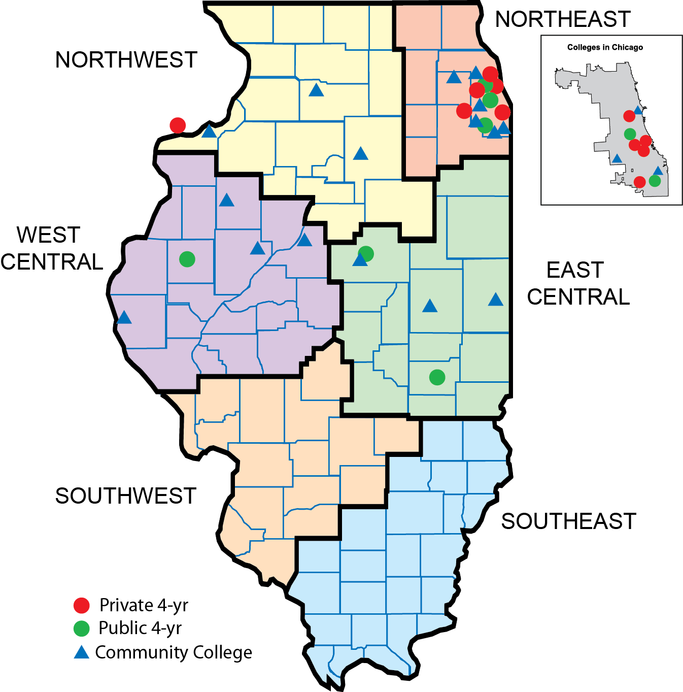
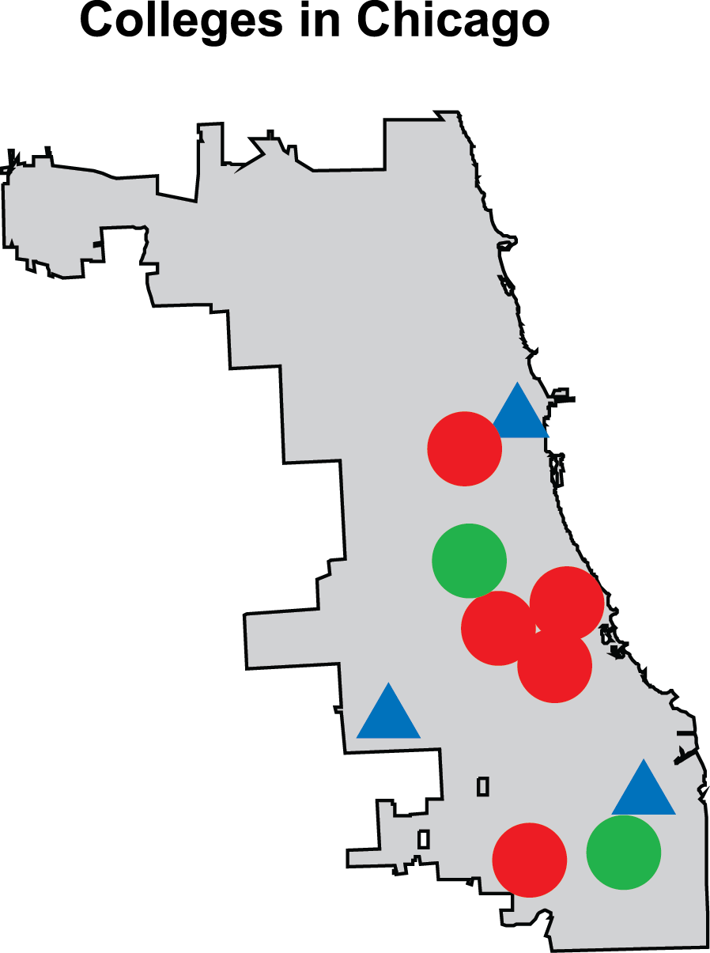
Geographic Location of Project Sites

Slide 17
Interview Process
Digitally recorded the interviews
Developed detailed summaries structured with the interview protocol
Provided interviewee with the opportunity to clarify statements, retract statements entirely, and even provide entirely new ideas
In some instances we asked the interviewees to provide clarification regarding some of their responses
Validated summaries were cleansed of identifying information and uploaded to a qualitative software package

Slide 18
Coding Process

Slide 19
Overarching Coding Structure
Based somewhat on the interview protocol.
Overarching goals of the implementation project.
Each theme had between two and six sub-topics.
Notes:
- Do we want to reference

Slide 20
Motivation for Participation
Improve articulation between community colleges and four-year institutions.
Build partnerships and networks among community colleges and four-year programs.
Four-year partners also discussed the potential for increased recruitment of transfer students, as well as an increase in diversity of their early childhood students.
Increasing degree completion of transferring students as a desired outcome of the collaborations and grant activities.
Notes:
Participants discussed different avenues for articulation efforts including improving the quality of instruction, developing standardized processes for advising and transferring, increasing and coordinating field experiences, and addressing the evolving early childhood standards, including the Gateways credentialing framework.
. Participants expressed the desire for these collaborations to result in improved communication and shared resources

Slide 21
Motivation for Participation cont.
Meeting students’ needs
Ensuring a smooth transition to decrease credit loss and increase affordability for students
Providing support to pass the Test of Academic Proficiency
Creating opportunities to provide secondary ESL endorsements
Developing support structures to help students succeed after the transfer
Increasing marketability among graduates

Slide 22
Institutional Barriers
Institution or partnership specific
Preventing goal attainment and/or partnership development
Most were historical in nature
Often wedded with a catalyst

Slide 23
Sub-Topics within the Institutional Barriers Theme
Bureaucratic Treading
Operating within institutional contexts and cutting through red-tape
Past Issues with Articulation
Usually historical
Issues with Advising
Need for clearly communicated transfer pathways
Major Institutional Change
Turnover/ program change

Slide 24
Representative Quotes within the Institutional Barriers Theme
Bureaucratic Treading- “What always seemed to get lost is when things move from the faculty member to faculty member they are fine because they know each other and are in the same field. But when it advances through the systems that are in place, people don’t understand.”
Past Issues with Articulation-“This institution has historically struggled with articulation and transfer for students.”
Issues with Advising- “Previously, transfer was up to the discretion of whoever was in the counseling office and was more vague.”
Major Institutional Change- “The original grant proposal was developed by two administrators, both of whom are no longer in those positions and are no longer in the College of Education.”

Slide 25
Systemic Barriers
Global/ common among multiple partnerships
Defined the challenging contexts in which the partnerships were operating
Particularly, the contexts that impede timely goal attainment

Slide 26
Sub-Topics within the Systemic Barriers Theme
Logistical Difficulties
Mostly centered on time-related issues
Initiative Overload
Related to new standards, initiatives, and program requirements
Characteristics of EC Students
Ascribed characteristics of EC students, particularly community college students

Slide 27
Sub-Topics within the Systemic Barriers Theme cont.
Institutional Bias
Notion that four-year institutions have traditionally been viewed higher on the educational hierarchy
Complexity of EC Education
Generally discussed in the student context

Slide 28
Representative Quotes within the Systemic Barriers Theme
Logistical Difficulties-“Good things don’t happen in three months, creativity takes time.”
Initiative Overload-“Illinois teaching requirements have changed and consequently courses need to be changed. Individual institution requirements also caused additional fitting of puzzle pieces.”
Characteristics of EC Students-“I learned that community college students are a very different group than typical four-year students. Many work full time, commute to school, etc.”

Slide 29
Representative Quotes within the Systemic Barriers Theme cont.
Institutional Bias-These students seem to perceive the community college as more or less a continuation of high school, and they are ready for something different.
Complexity of EC Education-“... if community college students are provided with any more information related to the hurdles of passing, let alone meeting the costs, of additional expectations, they may further see entering the field of education as unenticing and overwhelming.”

Slide 30
Catalysts
Provided movement towards goal attainment
Many adopted from McQuaid’s (2009)
Often a response or reaction to a historical or contextual barrier

Slide 31
Sub-Topics within the Catalysts Theme
Shared Values
Gaining a contextual understanding of the partners
Capacity for Cooperation
Related to the ability of the individual partners to effectively engage in the partnership and add value to the process
Grant Provided Impetus
The grant provided the structure and support to meet goals

Slide 32
Sub-Topics within the Catalysts Theme cont.
Innovative Steps
a) advising; b) test preparation; c) dissemination/sharing; and d) integration of community college transfer students
Use of Technology
were placed in the context of overcoming barriers, either systemic or institutional
Integral Player
key player as being integral to achieving grant-related goals and many times the key player was the principal investigator

Slide 33
Representative Quotes within the Catalysts Theme
Shared Values- “Previously these discussions have been an institutional focus, now they are focused around the students.”
Capacity for Cooperation- “The opportunity to meet face to face was great. Communicating with them via email is one thing, but gaining an understanding of them as people and knowing their teaching styles was extremely beneficial.”
Grant Provided Impetus-“ The grant was the ‘dike’ to hold off other responsibilities/commitments for a short time to focus on grant activities.”

Slide 34
Representative Quotes within the Catalysts Theme
Innovative Steps- “Additionally, everything that is done is being presented to a wider audience. When possible the two-year representative is included in these presentations.”
Use of Technology- The only barrier is distance from the other meetings, which was fixed by an online meeting service.
Integral Player- The participant reported the importance of proper leadership from a non-authoritarian principal investigator who is very open to the ideas of all the partners.

Slide 35
Potential Long-term Impacts
Overarching
Could not be measured in the timeframe of the grant

Slide 36
Sub-Topics within the Potential Long-Term Impacts Theme.
Professionalizing EC Workforce
raising the aggregate level of professional expertise in the field
Pathways
increasing the number of educational and/or career pathways for students
Enrollment
impacts on enrollment for both sides of the partnership
Societal/Systemic Improvement.
larger societal impacts with a heavy emphasis on improved learning situations for children

Slide 37
Representative Quotes within the Potential Long-Term Impacts Theme
Professionalizing EC Workforce- “Raise the ability to be able to talk to the general public, families, school district, legislators about issues, now that they’ll have the language.”
Pathways-“This articulation will make early childhood education more affordable for students, will allow them to work while they are in college, and allow them to move around.”

Slide 38
Representative Quotes within the Potential Long-Term Impacts Theme
Enrollment-“The partnering institutions will benefit from well-trained students who want to go on to become teachers and who can diversify the teaching pool.”
Societal/Systemic Improvement- “Ultimately, our clients are young children, so we want the best possible program and the best model of delivery.”

Slide 39
Mediating Impacts
Already budding, direct result from grant
Precursory in nature
Framework for long-term impacts

Slide 40
Sub-Topics within the Mediating Impacts Theme.
Programmatic Improvements
improvements generally involved both the depth and scope of curricula
Partnership Development
both a grant-related impact and catalyst allowing other grant-related goals to be accomplished
Enhanced Articulation/Seamless Transition
provided the framework for many of the other grant-related activities and it had a precursory relationship with attaining other goals

Slide 41
Representative Quotes within the Mediating Impacts Theme
Programmatic Improvement-“They are now getting exposure throughout their college experience, rather than right at the end when they do their student teaching.”
Partnership Development-“The partners, the institutions, and the individuals are the main reason that I believe this grant has been working so successfully.”
Enhanced Articulation/Seamless Transition- “Still working on articulation, but hoping for a seamless 2+2 program.”

Slide 42
Frameworks
Neutral references to new program requirements and standards.

Slide 43
Sub-Topics within the Frameworks Theme
Considering New Program Requirements
Usually framed with the Gateways Credentials
New ECE Program Redesign
ECE, as a whole, is in transition with several emerging program requirements.

Slide 44
Representative Quotes within the Frameworks Theme.
Considering New Program Requirements-“Credentialing will be worked right into the coursework. When students enter their first semester, they will be enrolled and walked through the Gateways Registry.”
New ECE Program Redesign-“The first goal was a complete redesign of the early childhood program to address the evolving standards including those stemming from various bodies such as the state and professional organizations.”

Slide 45
Views of the Current Grant Process
1. Almost exclusively positive
Many respondents mentioned their intentions or hopes of applying again
“Grant opportunities like these push us to do this difficult work that we would not have done otherwise.”
“This current grant provides a wonderful and outstanding model.”
Initial skeptics were pleasantly surprised at the end
“Often wondered if it would all lead to the end goal of reaching the students. But it did…It was incredibly worthwhile to go through the whole process.”
Notes:
The one consistent critique of the process, often embedded within a more positive response, was that due to grant restrictions it was more difficult for the community colleges to work with multiple four-year partners. To do so, they had to be a part of multiple projects. While four-year institutions could work with multiple community college partners as part of the same grant.
Then again, there were some positive un-intended consequences from that in that the community college partners on more than one grant could bring in multiple perspectives.

Slide 46
Views of the Current Grant Process
2. Cataylst for new dialogue and conversation
“The grant has allowed for a bigger conversation of the education system as a whole and has allowed for institutions to realize how similar they are.”
“Those people that applied for the grant are not only motivated to help their institutions, but are also motivated to help the profession.”
Notes:
(not only in terms of articulation) but how the partnerships can help the profession as a whole, in addition to how EC fits into the larger P20 system and society as a whole
Early childhood educators prepare the individuals who raise the children of Illinois.
Some of the specific curricular/ programmatic enhancement could also serve to provide greater opportunities to individuals from traditionally underserved populations. There is this idea that math serves as a discrimanatory bar, keeping some people out of STEM jobs, etc. Early math and other programs focusing on numeracy could serve to help eliminate or weaken that discrimanatory bar.

Slide 47
Views Regarding the Grant Process
3. Overall the structure and support were beneficial, probably more so than the money
“The grant provided the structure and support necessary to accomplish the goals and move from talk and discussion to action.”
“The money is the draw for this kind of work, but the money isn’t sustained in terms of following through. But because the grant got us started, it contributed to both the commitment and to the work.”
Notes:
A few other respondents mentioned how folks involved in EC get together quite frequently to discuss doing the things that were identified in the grant; however, everyone goes back to their respective institution and get entangled with other things (administrative issues, etc.).
The grant provided outside validation regarding the importance of EC education and the activities/goals outlined in the proposals. This sometimes helped get reluctant or busy adminsitrators on board.
The grant itself was sort of a catalyst propelling the partners into collaborative active.

Slide 48
Major Findings
Most of the partnerships were moving towards achieving their grant-related goals
The grants had a fairly large positive impact, particularly in terms of:
partnership development;
in enhancing articulation pathways between the partners;
integration of the Gateways Credentials into programs and into the transfer process.
Some of the themes and sub-topics that were established in analyzing the interview responses were directly related to key ideas within partnership development theory, as described by McQuaid (2009).
Identified barriers were often wedded to a catalyst

Slide 49
Major Findings cont.
Views regarding the grant system and the partnerships were not universally positive
The grant system perpetuated existing perceived biases
The short timeframe was sometimes viewed in a negative light
Another interviewee mentioned that although the partnership in question has traditionally been strong, the grant did not lead to significant change.

Slide 50
Select Innovative Steps: Cross-Advising
Sound advising practices mediate the influence of formalized articulation
It serves as an academic, advising, and cultural bridge
Best practices identified by Karp (2014) and Council of Independent Colleges (2014)
High-touch services
How to bring such advising practices to scale and establish their cost effectiveness?

Slide 51
Select Innovative Steps: Cultural Bridge
Related to Tinto’s (1987) Theory of Integration
Creating an environment that allows for a psychological and social attachment to be formed
Transfer shock
Create opportunities for transfer students to be active in both institutions during their first two years to ease the transition

Slide 52
Select Innovative Steps: Articulation and Early Commitment
Developing such highly structured transfer was a common goal with the overwhelming majority of the partnerships.
Specificity is the key to such agreements, in terms of the sending and receiving institutions, the majors, and articulated courses.
Slight deviations from the plan or uncertainty about a major at the beginning of one’s college career might necessitate additional time to degree completion.
We argue that more must be done to get community college students potentially interested in ECE to commit to that major earlier in their academic career.
Dual-credit could be one option

Slide 53
Recommendations for Practice
Frame discussions and goals using a student-centric approach
Include necessary players at the table
Rotate meeting sites, at times hold meetings in informal settings
Integrate community-based entities into the partnership
Within-institution communication
Use technology to supplement traditional face-to-face meetings and enhance the flow of information between partners

Slide 54
Final Thoughts
Need for Continuity
Beyond the funding period and scope of the grant
So the accomplishments outlive the current partners
Grant was important in moving the partnerships past many of the identified barriers
Grant provided structure allowing for programmatic and curricular enhancements
Grant necessitated accountability

Slide 55
Final Thoughts cont.
Amicability within the Profession
“There are no mean people in Early Childhood.”
“…same heart….”
“…early childhood educators are not mean and very creative when given the opportunity.”
“Everyone in Early Childhood is nice.”

Slide 56
Questions?

Slide 57
For Additional Information Contact
Eric Lichtenberger
(618) 650-3017
elichte@siue.edu
Illinois Education Research Council

