Slide 1
PreK-3 Danielson FfT Research Study
2015 Gateways to Opportunity Higher Education Forum
Lisa Hood, Ph.D.
Center for the Study of Education Policy, Illinois State University
For more information: lhood@ilstu.edu
Funded by the McCormick Foundation
Notes:
Welcome and Connector: 20 minutes
Introductory Slide that should be up when participants come into the session; Quick introduction of facilitators

Slide 2
Agenda
Setting the Context for the Work
Connect to the PreK-3 Danielson Validation Project:
Connect to the Danielson Framework and PreK-3
Implications for Early Childhood Teacher Preparation
Questions/Feedback
Notes:
Welcome and Connector: 20 minutes
Give brief review of the key priorities of the session as displayed on screen (they click in one at a time)

Slide 3
Setting the Context
Performance Evaluation Reform Act of 2010 (PERA): Legislative Requirements
Concern from the field about the misalignment between early childhood programs and K-12
Danielson Validation Study—using the Framework as a tool for creating a common vision of what effective and developmentally appropriate teaching across all grade levels, particularly PreK-3rd grade in this study

Slide 4
Project Work to Date
September 2012 – December 2013: Convened early childhood (PreK-3) stakeholders to develop early learning examples for the rubric (SEE HANDOUT)
Winter 2012: NBCT’s developed early learning examples and coded PreK-3 videos using Framework for use in training
June 2014 – Present: Conducting the PreK-3 Danielson Validation Study
January 2015 - Present: Convening Preschool for All coaches to review and revise the early learning examples for the rubric
March 2015 – Present: Working with The Center to plan for training on the Danielson for PreK teachers

Slide 5
Validation Study Purpose
To study whether the Danielson Framework is a valid and reliable tool for evaluating teachers in early childhood classrooms.
To study whether the framework provides accurate and reliable data that PreK-3rd grade teachers and their supervisors can use to
identify strengths and areas for growth;
use that data to engage in professional conversations, coaching, and targeted PD to promote teachers’ growth.
To develop training and resources that support EC teachers and their supervisors in their use of the Framework and implement their teacher evaluation system.

Slide 6
Study Participants
7 Districts
4 Early Learning Centers
7 Schools
1 Community-Based Center
North (3), Central (2), Southern (3); Urban (1), Rural (2), Small Urban/Big Town (5)
26 Teachers(14 PreK, 12 Elementary)
Internal Observers:
1 Teacher Leader
2 PreK Coordinators
9 Principals
External Observers
PreK-3 administration and teaching experience
Previous evaluation experience using the Danielson Framework

Slide 7
Students per Grade (n=620)

Slide 8
Student Ethnicity (N=548)

Slide 9
Special Education (N=191)
Lunch Status (N=268)

Slide 10
Validating the Framework
Quantitative Measures
Student assessment scores—is there a correlation between the observation data and student growth on assessments? If not, what does it tell us about the Framework or the assessments?
Evaluator and external observer evidence comparisons—is there a discrepancy in the critical attributes identified as a result of the evidence collected between the evaluator and the external observer? If not, where are the discrepancies?

Slide 11
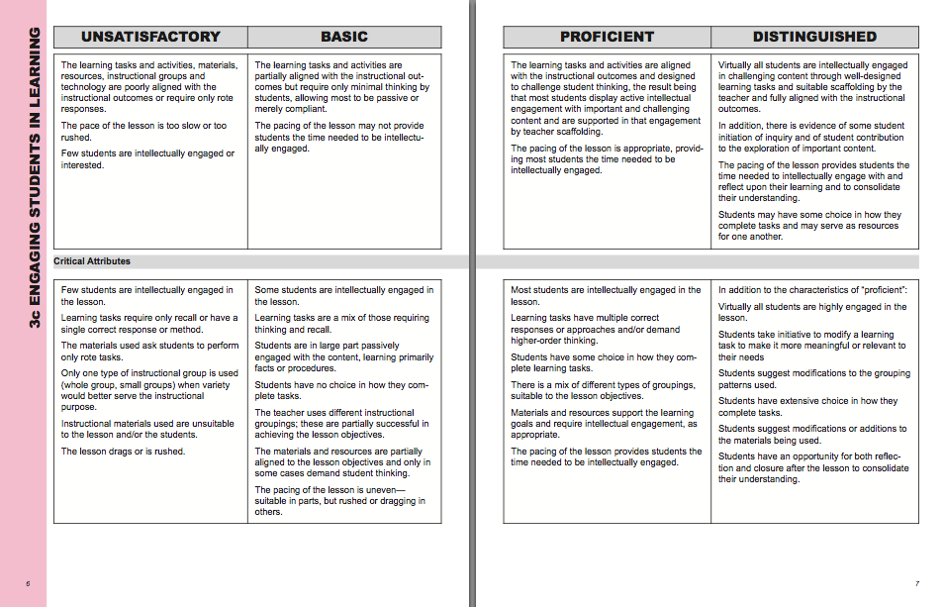
Notes:
Agenda Priorities: Experience an ECE Training Module
Plan-Teach-Reflect-Apply Cycle for Professional Learning using Observation/Conversations: 65 minutes
Materials Needed: Participant Guidebook and EC Data Set
Remind the participants that data in an individual component can cross over the different levels of practice so sometimes seeming to “dance” between the levels and the teacher and evaluator look for the preponderance of data. CLICK the different levels as you share this.

Slide 12
Validating the Framework
Qualitative Study
Qualitative analysis of the observation data
Interviews, focus groups, document analysis
Collect data on how the Framework is used by evaluators and PreK-3 teachers to identify strengths and weaknesses in professional practice and support professional development
In what ways is the Framework most useful and effective?
Are the student assessments used in the study appropriate? What would teachers and leaders recommend?
Where are there challenges, misuses, or misinterpretations?
What training and resources are need to support the Framework’s use and to support a useful and effective teacher evaluation process?

Slide 13
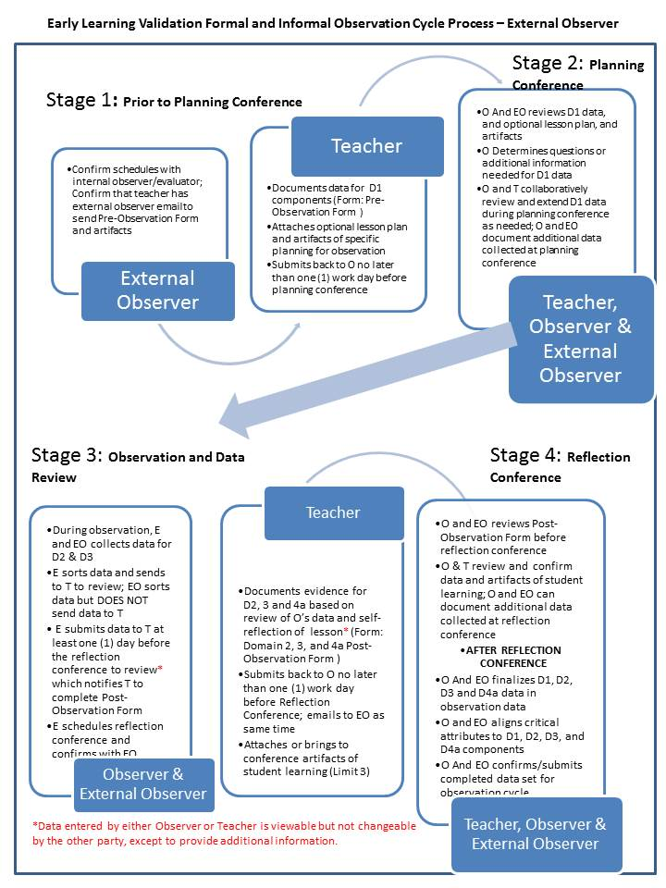

Slide 14
Update on the Research
Fall observation data and student assessment data collected (some cleanup may be necessary)
Beginning to analyze the fall data for inter-rater reliabilities, qualitative analysis of observation data
Spring data collection
Informal Observations (April 1 – May 15)
Student assessment data (to UIUC late May)
Qualitative Interviews/Group Interviews (April 15-May 15) a sample of teachers and administrators

Slide 15
Update on the Research
Summer
Final data analysis
Compile report
Final report out to the research participants
Convening (10am to 2pm)
Late June or Early August (depending on data analysis)

Slide 16
Student Assessment Data Assessments in Use
GOLD Assessment (3 schools/programs)
DIBELS (Reading assessment) (2 schools)
EnVision (Math assessment) (2 schools)
The Work Sampling System (2 schools/programs)
DIAL 4 Screener (2 schools/programs)
ESI-R with Preschoolers (Sept-Oct) Screening
Spring DECA (April-May) Screening
Scholastic Reading Inventory (SRI)
Assessment Evaluation Program System for Infants & Children
Early Learning Scale
Beverly Tyner Reading Screening Tool
Fountas & Pinnell Benchmark Assessment (Reading)
Fountas and Pinnell Reading Text Level, In Spanish and English, 3 times a year
Discover Ed
Rigby Reads (1st graders only)
LID (Letter Identification) in English and Spanish up to 3 times a year
MAP
Reading and Math, 3 times a year, adaptive test
SUPERA - in Spanish, Reading, Math, & Language Annually, in Fall, scores recorded are percentiles
CogAT, IQ test, once during 3rd grade Fall
Common Core Assessment
STAR Math Assessment (3rd-6th grade only) Given in Dec-January

Slide 17
Questions?
Before we continue, any questions about the research study?

Slide 18
Danielson Framework for Teaching
Overview
Notes:
Agenda Priority: Connect to the FfT Early Learning Validation Project: Sharing Qualitative and Quantitative Design and Timeline
Welcome and Connector: 20 minutes
Materials Needed: PPT slides
Lisa provides overview of the grant/research project

Slide 19
Foundations of the Danielson Framework
A Brief History of the Evolution of the Framework for Teaching
1996: “Enhancing Professional Practice: A framework for teaching” published by ASCD. Based on the research compiled by the Educational Testing Service for the Praxis III.
2007: Second edition of “Enhancing Professional Practice: A framework for teaching” published by ASCD. It updated the research base from the first edition. It also added a chapter providing frameworks for non-class­room specialists (school nurses, librarians, etc.) who are typically part of a teacher bargaining unit but who, while they do some teaching, typically do much more besides teaching.
2011: As a result of participating in several large research studies, notably the Measures of Effective Teaching (MET) project funded by the Gates Foundation, it became clear that precision of language in the levels of per­formance was critical for accuracy of judgment of teacher performance on the Framework for Teaching. The 2011 version of the framework for teaching offered that greater precision, and also provided rubrics written at the component, rather than the element, level. In addition, it added critical attributes and possible examples of each level of performance of each component of the framework.
2013: The evolution of even more precise language continued with the 2013 edition of the framework for teaching evaluation instrument; it also made explicit the instructional implications of the Common Core State Standards. From its inception, the framework has always been built on the same conceptual base as the CCSS; the 2013 edition makes those connections explicit.
Notes:
The Framework for Teaching has maintained the original structure and domains/components since Charlotte released it in 1996. There have been purposeful changes that Charlotte has provided based on other national initiatives and priorities that integrate with the Framework.

Slide 20
Assumptions and Features of the Danielson Framework
Constructivist: teacher and student working together to engage learning
Teaching is purposeful: teachers make choices based on instructional goals
Comprehensive & coherent: focused on entire teaching process (in the classroom and out)
Generic: common features of teaching regardless of grade level or setting
Aligned with research and teaching standards
Public: accessible to teachers; advises book studies and discussions to modify language to fit context
Cycle of Inquiry and professional growth (PTRA cycle)
Independent of a particular teaching methodology
Notes:
The Framework for Teaching has maintained the original structure and domains/components since Charlotte released it in 1996. There have been purposeful changes that Charlotte has provided based on other national initiatives and priorities that integrate with the Framework.

Slide 21
Framework Vocabulary
4 Domains
22 Components
76 Elements
Notes:
21

Slide 22
Framework Domains
Domain 1 – Planning and Preparation
What a teacher knows and does in preparation for teaching.
Domain 2 – The Classroom Environment
All aspects of teaching that lead to a culture for learning in the classroom.
Domain 4 – Professional Responsibilities
Professional responsibilities and behavior in/out of the classroom.
Domain 3 – Instruction
What a teacher does to engage students in learning.
Notes:
22
Mention that the framework is laid out in this fashion to represent the cyclical nature of teacher’s work.

Slide 23
The Domains and Components
Domain 1: Planning and Preparation
Demonstrating Knowledge of Content and Pedagogy
Demonstrating Knowledge of Students
Selecting Instructional Outcomes
Demonstrating Knowledge of Resources
Designing Coherent Instruction
Designing Student Assessment
Domain 2: The Classroom Environment
Creating an Environment of Respect and Rapport
Establishing a Culture for Learning
Managing Classroom Procedures
Managing Student Behavior
Organizing Physical Space
Domain 4: Professional Responsibilities
Reflecting on Teaching
Maintaining Accurate Records
Communicating with Families
Participating in a Professional
Community
Growing and Developing Professionally
Showing Professionalism
Domain 3: Instruction
Communicating with Students
Using Questioning and Discussion
Techniques
Engaging Students in Learning
Using Assessment in Instruction
Demonstrating Flexibility and Responsiveness
Notes:
23

Slide 24
Levels of Performance
Unsatisfactory – Professional practice shows evidence of not understanding the concepts underlying the component - may represent practice that is harmful - requires intervention
Needs Improvement (Basic)– Professional practice shows evidence of knowledge and skills related to concepts underlying the component- but inconsistent performance due to lack of experience, expertise, or commitment
Notes:
Share this after you have done the chart on each one. They will appear one at a time.

Slide 25
Levels of Performance
• Proficient – Professional practice shows evidence of thorough knowledge of concepts underlying the component. This is successful, accomplished, and effective professional practice.
Excellent (Distinguished) – Professional practice shows evidence of thorough knowledge of concepts at highest level of expertise and commitment. Professional practice provides leadership and facilitation for others in this professional area. Classroom evidence is based upon student assumption of responsibility for learning.
Notes:
Share this after you have done the chart on each one. They will appear one at a time.

Slide 26
Levels of Performance
NEEDS IMPROVEMENT
Level 2
“New” EXCELLENT
Level 4
UNSATISFACTORY
Level 1
PROFICIENT
Level 3
Lack of Unorganized Harmful Refusal Unclear Non-Participatory
Inconsistent Partial General Attempts Limited Participatory
Consistent Appropriate Successful Frequent Specific Collaborative
Seamless Subtle Skillful Preventative Extensive
Leadership
Below Licensing Standard
“Cease and Desist”
New or Developing
Focused Mentoring or Coaching
Teacher-Directed Success
Collaborative Learning
Student-Directed Success
Collaborative Leadership
Experience, Expertise and Commitment
Notes:
The components of the 2013 FfT are further clarified through the levels of performance. At the beginning of school and through much of our daily work directly with students and peers, we dance between the levels of performance, especially proficient and the “new” excellent.
At the beginning of the year we do a lot of setting up the learning environment for success through modeling, think alouds, guided practice etc at the proficient level of teaching. This level has teacher-directed success and provides an avenue for teachers to collaboratively share “what works”.
When students are ready for sharing and extending some of the learning experiences in Domain 2 and 3, the teacher provides scaffolded support to learning into the “new” excellent. At this level we see student-directed success where the teacher moves to the role of “guide on the side” and provides more individually support to students. We also see the teacher providing collaborative leadership at this level.
The level of Needs Improvement is where often new teachers (new to profession or new to subject or grade level) see some of their beginning practices where they have limited or inconsistent planning or instructional practice. This is why focused mentoring and coaching is provided at this level of practice.
Finally, the unsatisfactory level is harmful practice that does not benefit students, peers, or the individual teacher. At this level, the administrator needs to address immediately with the teacher the harmful practice and provide a clear, concise process for moving rapidly to improved practice.

Slide 27
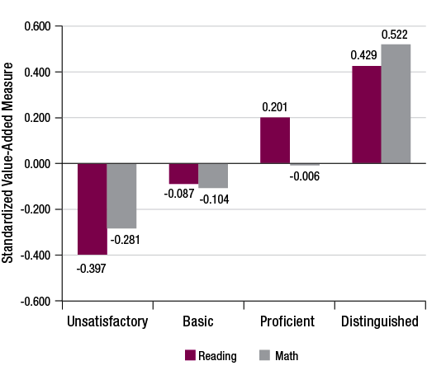
Strong Relationship between Observation Ratings and Value Added Methodologies (CCSR))
Results:
Ratings explained a significant portion of variation in VAM (Value Added Methodologies) in reading and math
Relationship stronger in reading than in math
Teachers with high observation ratings had high VAMs (and vice-versa)
Notes:
Busy slide…
Can the graph be displayed while you describe the results?? Will this be in the handout?

Slide 28
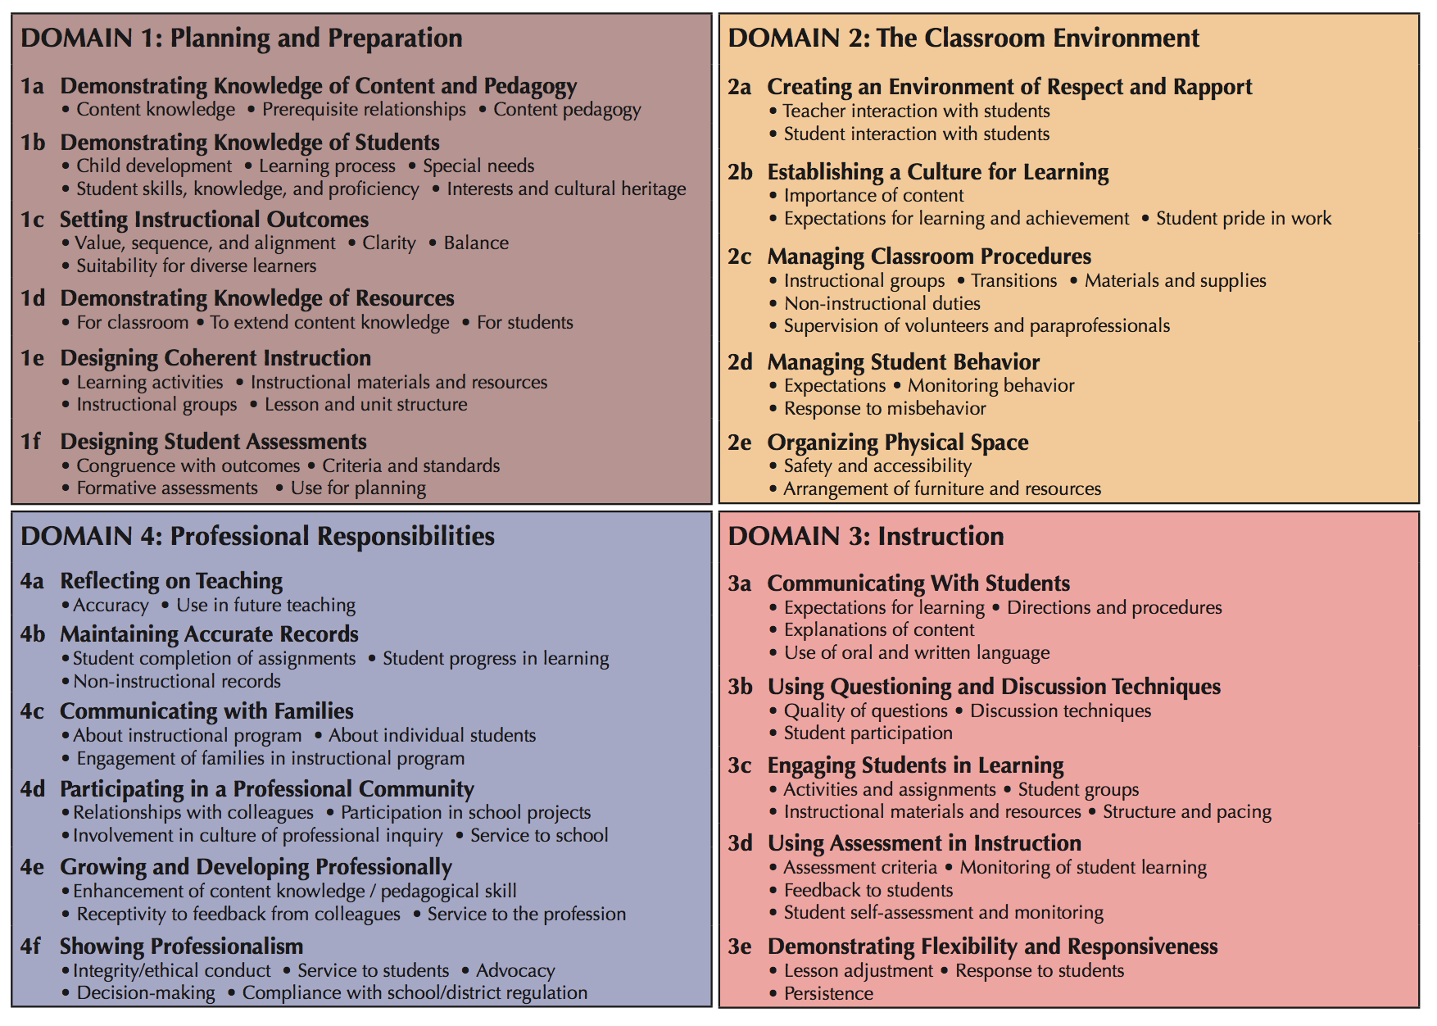
D1 Big Idea: Instructional “Magic Maker”
D2 Big Idea: Gatekeeper
D1 DESIGN Cluster: 1c/1f/1e
D2 MANAGEMENT Cluster: 2c/2d/2e
The Danielson Framework for Teaching
D3 Big Idea: Instructional “Magic”
D4 Big Idea: Change Agent
D2/D3 ENGAGEMENT Cluster: 2b/3a/3b/3c
D4 PROFESSIONALISM Cluster: 4d/4e/4f
D3 ASSESSMENT Cluster: 3d/3e
Notes:
The presenter asks each participant to put four stickies on the front of the FfT. One sticky note on D1, one on D2 etc. Remind them that this Cue Card Review will give additional priorities and ideas to think about and use as we implement the FfT into the new teacher evaluation process.
Ask the participants to put three bullets on each sticky note. One bullet stands for the BIG IDEA of the Domain, the second bullet is for the anchor component which is the link to the other components in the domain and the third bullet is a cluster that is important to the domain.
Domain 1: The Big IDEA is that Domain 1 is what sets the “magic” of learning up for success. The common core requires that we individually and collaboratively plan for key content to be taught in new, more extensive ways so we will have to plan purposefully to make that happen. 1e is the anchor component. Ultimately Domain 1 asks that we plan “coherent instruction” by determining instructional content and outcomes, deeply knowing our students, developing or selecting ongoing assessments and designing highly engaging learning activities. Finally, Domain 1 is organized around a DESIGN cluster that helps the teacher to design backward with first 1c – Learning Outcome, then determining 1f the formative assessment and then develop appropriate approaches for learning through 1e.
Domain 2: The big IDEA is this Domain is the “gatekeeper” to opening or closing the door to Domain 3 – Instruction. The more that students feel welcome and supported through Domain 2, the more risks and challenges Ss will take in Domain 3. So the anchor component is 2b – Culture for Learning. While the other components are really important to supporting student involvement, 2b is about “the worth-i-ness” of learning. The MANAGEMENT cluster – 2c, 2d, 2e represent “first things first” in the learning environment and help students to be able to understand their roles and expectations for working in the classroom independent of the teacher and inter-dependent with other students.
Domain 3: The big IDEA of Domain 3 is “Magic”…when teachers support students to intellectually commit and work together to learn challenging information, there is a feeling almost like something magical is going on…high level learning. Based on the purposeful planning that we do in Domain 1, Domain 3 provides the components to support students gaining and extending important information. It is no surprise that Component 3c is the anchor to Domain 3. Engaging students in learning is teaching job #1! It is also why schools exist ☺! There are TWO clusters, the first cluster is COMMUNICATION with 3a as the lead but also linking to Domain 2a and 2b. Communicating the directions, procedures and instructional expectations is challenging and it is an important part of teaching for learning. The second cluster, ENGAGEMENT is the BIGGIE and most challenging. Taken all together as 3b, 3c, and 3d or broken apart to dive into individually, these components ask for high-leverage/thoughtful questions, using a variety of discussion techniques, facilitating engaging activities and formatively checking on student learning. Each of these are really challenging but together are REALLY IMPORTANT work in teaching.
Domain 4: The final BIG IDEA is being a “Change Agent” in Domain 4. Domain 4 provides the capacity for teachers to reflect, use records, work with families and their peers to continue to grow their practice. The work of teaching/student learning is never done. The anchor for Domain 4 is 4a – Reflecting on Teaching but it is also in some ways the anchor for the whole framework. We want to build that reflective practice aligned with other Domain 4 components to maximize our work and support student improvement. The Domain 4 cluster is PROFESSIONALISM – 4d (working well with others), 4e, (continuing to grow our individual practice), and 4f (being an advocate for students, families and school/district).

Slide 29
D1 Big Idea: Instructional “Magic Maker”
D2 Big Idea: Gatekeeper
D1 DESIGN Cluster: 1c/1f/1e
D2 MANAGEMENT Cluster: 2c/2d/2e
The Danielson Framework for Teaching
D3 Big Idea: Instructional “Magic”
D4 Big Idea: Change Agent
D2/D3 ENGAGEMENT Cluster: 2b/3a/3b/3c
D4 PROFESSIONALISM Cluster: 4d/4e/4f
D3 ASSESSMENT Cluster: 3d/3e
Notes:
The presenter asks each participant to put four stickies on the front of the FfT. One sticky note on D1, one on D2 etc. Remind them that this Cue Card Review will give additional priorities and ideas to think about and use as we implement the FfT into the new teacher evaluation process.
Ask the participants to put three bullets on each sticky note. One bullet stands for the BIG IDEA of the Domain, the second bullet is for the anchor component which is the link to the other components in the domain and the third bullet is a cluster that is important to the domain.
Domain 1: The Big IDEA is that Domain 1 is what sets the “magic” of learning up for success. The common core requires that we individually and collaboratively plan for key content to be taught in new, more extensive ways so we will have to plan purposefully to make that happen. 1e is the anchor component. Ultimately Domain 1 asks that we plan “coherent instruction” by determining instructional content and outcomes, deeply knowing our students, developing or selecting ongoing assessments and designing highly engaging learning activities. Finally, Domain 1 is organized around a DESIGN cluster that helps the teacher to design backward with first 1c – Learning Outcome, then determining 1f the formative assessment and then develop appropriate approaches for learning through 1e.
Domain 2: The big IDEA is this Domain is the “gatekeeper” to opening or closing the door to Domain 3 – Instruction. The more that students feel welcome and supported through Domain 2, the more risks and challenges Ss will take in Domain 3. So the anchor component is 2b – Culture for Learning. While the other components are really important to supporting student involvement, 2b is about “the worth-i-ness” of learning. The MANAGEMENT cluster – 2c, 2d, 2e represent “first things first” in the learning environment and help students to be able to understand their roles and expectations for working in the classroom independent of the teacher and inter-dependent with other students.
Domain 3: The big IDEA of Domain 3 is “Magic”…when teachers support students to intellectually commit and work together to learn challenging information, there is a feeling almost like something magical is going on…high level learning. Based on the purposeful planning that we do in Domain 1, Domain 3 provides the components to support students gaining and extending important information. It is no surprise that Component 3c is the anchor to Domain 3. Engaging students in learning is teaching job #1! It is also why schools exist ☺! There are TWO clusters, the first cluster is COMMUNICATION with 3a as the lead but also linking to Domain 2a and 2b. Communicating the directions, procedures and instructional expectations is challenging and it is an important part of teaching for learning. The second cluster, ENGAGEMENT is the BIGGIE and most challenging. Taken all together as 3b, 3c, and 3d or broken apart to dive into individually, these components ask for high-leverage/thoughtful questions, using a variety of discussion techniques, facilitating engaging activities and formatively checking on student learning. Each of these are really challenging but together are REALLY IMPORTANT work in teaching.
Domain 4: The final BIG IDEA is being a “Change Agent” in Domain 4. Domain 4 provides the capacity for teachers to reflect, use records, work with families and their peers to continue to grow their practice. The work of teaching/student learning is never done. The anchor for Domain 4 is 4a – Reflecting on Teaching but it is also in some ways the anchor for the whole framework. We want to build that reflective practice aligned with other Domain 4 components to maximize our work and support student improvement. The Domain 4 cluster is PROFESSIONALISM – 4d (working well with others), 4e, (continuing to grow our individual practice), and 4f (being an advocate for students, families and school/district).

Slide 30
1c: Setting Instructional Outcomes
What to Look/Listen for in this component?
Rigorous and challenging outcomes central to the discipline
Focus on student learning and not student activity
Outcomes that can be assessed
Differentiated outcomes for varied student abilities
Examples of Component @ Proficient/Excellent…
Proficient:
The learning outcomes for an apple study are identified as life cycle, key vocabulary, sequencing, measurement and counting.
Excellent:
The teacher develops a concept map that links previous current and future learning goals and outcomes by connecting the essential idea of life cycles beginning with apples and extending to humans/animals.

Slide 31
1f: Designing Student Assessments
What to Look/Listen for in this component?
Lesson plans correspond with assessments
Assessments correspond with outcomes
Multiple/various opportunities for students to demonstrate outcomes
Students know expectations
Differentiated assessments when warranted
Formative assessments guide immediate instructional decisions
Examples of Component @ Proficient/Excellent…
Proficient:
The teacher uses a social emotional checklist with a numerical range, and narrative descriptors of levels to assess student behavior.
Excellent:
The teacher designs and/or uses instruments to measure social emotional growth in concert with other teachers and families.

Slide 32
1e: Designing Coherent Instruction
What to Look/Listen for in this component?
Lesson plans correspond with desired outcomes
References to prior learning
Activities represent higher level thinking
Students are given choices
Instructional groups are intentional and maximize learning
Plans are well structured and use various resources
Examples of Component @ Proficient/Excellent…
Proficient:
The teacher plans for students to complete a project in small groups; he/she carefully selects group members by their ability level and learning style.
Excellent:
After the cooperative group lesson, the students will reflect on their participation and focus upon “celebrations…what worked well” and “concentrations…what can we improve”.

Slide 33
D1 Big Idea: Instructional “Magic Maker”
D2 Big Idea: Gatekeeper
D1 DESIGN Cluster: 1c/1f/1e
D2 MANAGEMENT Cluster: 2c/2d/2e
The Danielson Framework for Teaching
D3 Big Idea: Instructional “Magic”
D4 Big Idea: Change Agent
D2/D3 ENGAGEMENT Cluster: 2b/3a/3b/3c
D4 PROFESSIONALISM Cluster: 4d/4e/4f
D3 ASSESSMENT Cluster: 3d/3e
Notes:
The presenter asks each participant to put four stickies on the front of the FfT. One sticky note on D1, one on D2 etc. Remind them that this Cue Card Review will give additional priorities and ideas to think about and use as we implement the FfT into the new teacher evaluation process.
Ask the participants to put three bullets on each sticky note. One bullet stands for the BIG IDEA of the Domain, the second bullet is for the anchor component which is the link to the other components in the domain and the third bullet is a cluster that is important to the domain.
Domain 1: The Big IDEA is that Domain 1 is what sets the “magic” of learning up for success. The common core requires that we individually and collaboratively plan for key content to be taught in new, more extensive ways so we will have to plan purposefully to make that happen. 1e is the anchor component. Ultimately Domain 1 asks that we plan “coherent instruction” by determining instructional content and outcomes, deeply knowing our students, developing or selecting ongoing assessments and designing highly engaging learning activities. Finally, Domain 1 is organized around a DESIGN cluster that helps the teacher to design backward with first 1c – Learning Outcome, then determining 1f the formative assessment and then develop appropriate approaches for learning through 1e.
Domain 2: The big IDEA is this Domain is the “gatekeeper” to opening or closing the door to Domain 3 – Instruction. The more that students feel welcome and supported through Domain 2, the more risks and challenges Ss will take in Domain 3. So the anchor component is 2b – Culture for Learning. While the other components are really important to supporting student involvement, 2b is about “the worth-i-ness” of learning. The MANAGEMENT cluster – 2c, 2d, 2e represent “first things first” in the learning environment and help students to be able to understand their roles and expectations for working in the classroom independent of the teacher and inter-dependent with other students.
Domain 3: The big IDEA of Domain 3 is “Magic”…when teachers support students to intellectually commit and work together to learn challenging information, there is a feeling almost like something magical is going on…high level learning. Based on the purposeful planning that we do in Domain 1, Domain 3 provides the components to support students gaining and extending important information. It is no surprise that Component 3c is the anchor to Domain 3. Engaging students in learning is teaching job #1! It is also why schools exist ☺! There are TWO clusters, the first cluster is COMMUNICATION with 3a as the lead but also linking to Domain 2a and 2b. Communicating the directions, procedures and instructional expectations is challenging and it is an important part of teaching for learning. The second cluster, ENGAGEMENT is the BIGGIE and most challenging. Taken all together as 3b, 3c, and 3d or broken apart to dive into individually, these components ask for high-leverage/thoughtful questions, using a variety of discussion techniques, facilitating engaging activities and formatively checking on student learning. Each of these are really challenging but together are REALLY IMPORTANT work in teaching.
Domain 4: The final BIG IDEA is being a “Change Agent” in Domain 4. Domain 4 provides the capacity for teachers to reflect, use records, work with families and their peers to continue to grow their practice. The work of teaching/student learning is never done. The anchor for Domain 4 is 4a – Reflecting on Teaching but it is also in some ways the anchor for the whole framework. We want to build that reflective practice aligned with other Domain 4 components to maximize our work and support student improvement. The Domain 4 cluster is PROFESSIONALISM – 4d (working well with others), 4e, (continuing to grow our individual practice), and 4f (being an advocate for students, families and school/district).

Slide 34
2c: Managing Classroom Procedures
What to Look/Listen for in this component?
Smooth routines
Little/no loss of instructional time during transitions
Students know the routines and play a role in carrying them out
Examples of Component @ Proficient/Excellent…
Proficient:
Teacher demonstrates effective classroom management. Some strategies including verbal reminders, timing devices, or songs are used to move children through the daily routine. Minimal instructional time is lost.
Excellent:
Teacher consistently demonstrates efficient classroom management. Teacher has established a predictable daily schedule with clear expectations. Students rely on established guidance including picture schedule and/or flowcharts which allows for seamless transitions and maximum instructional time.

Slide 35
2d: Managing Student Behavior
What to Look/Listen for in this component?
Clear standards of conduct
Positive caring relationship between teachers and students
Frequent monitoring of student conduct
Effective response to student misbehavior
Teacher reinforces positive behavior
Examples of Component @ Proficient/Excellent…
Proficient:
When the teacher shows the “quiet signal”, students quickly stop talking and most students model the “quiet signal” to the teacher.
Excellent:
In small groups, students show or remind other classmates of the classroom “quiet signal” as needed without prompting or reminders from teacher OR students make suggests for improving use of quiet signal during a classroom discussion.

Slide 36
2e: Organizing Physical Space
What to Look/Listen for in this component?
Safe and pleasant environment
Materials, resources, learning activities easily and equally accessible
Effective use of resources, technology and space
Examples of Component @ Proficient/Excellent…
Proficient:
The learning centers are organized and materials/supplies visually labeled with colored pictures or flowcharts for students to use independent of the teacher.
Excellent:
Students maintain the learning centers by using the center’s colored pictures or flowcharts that highlight how the center should look before moving to the next one.

Slide 37
D1 Big Idea: Instructional “Magic Maker”
D2 Big Idea: Gatekeeper
D1 DESIGN Cluster: 1c/1f/1e
D2 MANAGEMENT Cluster: 2c/2d/2e
The Danielson Framework for Teaching
D3 Big Idea: Instructional “Magic”
D4 Big Idea: Change Agent
D2/D3 ENGAGEMENT Cluster: 2b/3a/3b/3c
D4 PROFESSIONALISM Cluster: 4d/4e/4f
D3 ASSESSMENT Cluster: 3d/3e
Notes:
The presenter asks each participant to put four stickies on the front of the FfT. One sticky note on D1, one on D2 etc. Remind them that this Cue Card Review will give additional priorities and ideas to think about and use as we implement the FfT into the new teacher evaluation process.
Ask the participants to put three bullets on each sticky note. One bullet stands for the BIG IDEA of the Domain, the second bullet is for the anchor component which is the link to the other components in the domain and the third bullet is a cluster that is important to the domain.
Domain 1: The Big IDEA is that Domain 1 is what sets the “magic” of learning up for success. The common core requires that we individually and collaboratively plan for key content to be taught in new, more extensive ways so we will have to plan purposefully to make that happen. 1e is the anchor component. Ultimately Domain 1 asks that we plan “coherent instruction” by determining instructional content and outcomes, deeply knowing our students, developing or selecting ongoing assessments and designing highly engaging learning activities. Finally, Domain 1 is organized around a DESIGN cluster that helps the teacher to design backward with first 1c – Learning Outcome, then determining 1f the formative assessment and then develop appropriate approaches for learning through 1e.
Domain 2: The big IDEA is this Domain is the “gatekeeper” to opening or closing the door to Domain 3 – Instruction. The more that students feel welcome and supported through Domain 2, the more risks and challenges Ss will take in Domain 3. So the anchor component is 2b – Culture for Learning. While the other components are really important to supporting student involvement, 2b is about “the worth-i-ness” of learning. The MANAGEMENT cluster – 2c, 2d, 2e represent “first things first” in the learning environment and help students to be able to understand their roles and expectations for working in the classroom independent of the teacher and inter-dependent with other students.
Domain 3: The big IDEA of Domain 3 is “Magic”…when teachers support students to intellectually commit and work together to learn challenging information, there is a feeling almost like something magical is going on…high level learning. Based on the purposeful planning that we do in Domain 1, Domain 3 provides the components to support students gaining and extending important information. It is no surprise that Component 3c is the anchor to Domain 3. Engaging students in learning is teaching job #1! It is also why schools exist ☺! There are TWO clusters, the first cluster is COMMUNICATION with 3a as the lead but also linking to Domain 2a and 2b. Communicating the directions, procedures and instructional expectations is challenging and it is an important part of teaching for learning. The second cluster, ENGAGEMENT is the BIGGIE and most challenging. Taken all together as 3b, 3c, and 3d or broken apart to dive into individually, these components ask for high-leverage/thoughtful questions, using a variety of discussion techniques, facilitating engaging activities and formatively checking on student learning. Each of these are really challenging but together are REALLY IMPORTANT work in teaching.
Domain 4: The final BIG IDEA is being a “Change Agent” in Domain 4. Domain 4 provides the capacity for teachers to reflect, use records, work with families and their peers to continue to grow their practice. The work of teaching/student learning is never done. The anchor for Domain 4 is 4a – Reflecting on Teaching but it is also in some ways the anchor for the whole framework. We want to build that reflective practice aligned with other Domain 4 components to maximize our work and support student improvement. The Domain 4 cluster is PROFESSIONALISM – 4d (working well with others), 4e, (continuing to grow our individual practice), and 4f (being an advocate for students, families and school/district).

Slide 38
2b: Establishing a Culture for Learning
What to Look/Listen for in this component?
Values what is being learned
High Expectations for learning & participation
Expectation for high-quality work
Expectation & recognition for effort & persistence
Examples of Component @ Proficient/Excellent…
Proficient: The teacher says, “This activity is really important for us to learn about because we will be using it when…”
Excellent: The teacher shares personal interest with learning concept and then links the work to future learning.

Slide 39
3a: Communicating with Students
What to Look/Listen for in this component?
Clarity of lesson purpose
Clear directions and procedures specific to the lesson activities
Absence of content errors and clear explanations of concepts and strategies
Correct and imaginative use of language
Examples of Component @ Proficient/Excellent…
Proficient: The teacher models to Ss how to compare and contrast two stories.
Excellent: The teacher uses the Venn diagram to compare and contrast two stories while inviting Ss to add their ideas and relevant experiences as she “thinks out loud” the connections to the learning process.

Slide 40
3b: Using Questioning & Discussion Techniques
What to Look/Listen for in this component?
Questions of high cognitive challenge, formulated by both Ss and T
Questions with multiple correct answers or multiple approaches, even when there is a single correct response
Effective use of S responses and ideas
Discussion, w/the T stepping out of the central, mediating role
Focus on reasoning exhibited by Ss in discussion
High levels of S participation
Examples of Component @ Proficient/Excellent…
Proficient: The teacher poses a question, asking every S to draw a picture/write a brief response and then share with a partner.
Excellent: The teacher asks Ss in teams, “What is another way to figure this out?” and give teams time to develop additional ideas and then calls on one S from each group to share team’s ideas.

Slide 41
3c: Engaging Students in Learning
What to Look/Listen for in this component?
S enthusiasm, interest, thinking, problem-solving
Learning tasks that require high-level S thinking and invite Ss to explain their thinking
Ss highly motivated to work on all tasks and persistent even when the tasks are challenging
Ss actively “working,” rather than watching while their T works
Suitable pacing of the lesson: neither dragged out nor rushed, w/time for closure & S reflection
Examples of Component @ Proficient/Excellent…
Proficient: The teacher strategically plans rotations during center time to provide time for students to share their work with each other.
Excellent: The teacher intentionally provides limited explanations, instructions, and vocabulary necessary to complete center activities, and promotes student interaction to problem solve and find solutions.

Slide 42
D1 Big Idea: Instructional “Magic Maker”
D2 Big Idea: Gatekeeper
D1 DESIGN Cluster: 1c/1f/1e
D2 MANAGEMENT Cluster: 2c/2d/2e
The Danielson Framework for Teaching
D3 Big Idea: Instructional “Magic”
D4 Big Idea: Change Agent
D2/D3 ENGAGEMENT Cluster: 2b/3a/3b/3c
D4 PROFESSIONALISM Cluster: 4d/4e/4f
D3 ASSESSMENT Cluster: 3d/3e
Notes:
The presenter asks each participant to put four stickies on the front of the FfT. One sticky note on D1, one on D2 etc. Remind them that this Cue Card Review will give additional priorities and ideas to think about and use as we implement the FfT into the new teacher evaluation process.
Ask the participants to put three bullets on each sticky note. One bullet stands for the BIG IDEA of the Domain, the second bullet is for the anchor component which is the link to the other components in the domain and the third bullet is a cluster that is important to the domain.
Domain 1: The Big IDEA is that Domain 1 is what sets the “magic” of learning up for success. The common core requires that we individually and collaboratively plan for key content to be taught in new, more extensive ways so we will have to plan purposefully to make that happen. 1e is the anchor component. Ultimately Domain 1 asks that we plan “coherent instruction” by determining instructional content and outcomes, deeply knowing our students, developing or selecting ongoing assessments and designing highly engaging learning activities. Finally, Domain 1 is organized around a DESIGN cluster that helps the teacher to design backward with first 1c – Learning Outcome, then determining 1f the formative assessment and then develop appropriate approaches for learning through 1e.
Domain 2: The big IDEA is this Domain is the “gatekeeper” to opening or closing the door to Domain 3 – Instruction. The more that students feel welcome and supported through Domain 2, the more risks and challenges Ss will take in Domain 3. So the anchor component is 2b – Culture for Learning. While the other components are really important to supporting student involvement, 2b is about “the worth-i-ness” of learning. The MANAGEMENT cluster – 2c, 2d, 2e represent “first things first” in the learning environment and help students to be able to understand their roles and expectations for working in the classroom independent of the teacher and inter-dependent with other students.
Domain 3: The big IDEA of Domain 3 is “Magic”…when teachers support students to intellectually commit and work together to learn challenging information, there is a feeling almost like something magical is going on…high level learning. Based on the purposeful planning that we do in Domain 1, Domain 3 provides the components to support students gaining and extending important information. It is no surprise that Component 3c is the anchor to Domain 3. Engaging students in learning is teaching job #1! It is also why schools exist ☺! There are TWO clusters, the first cluster is COMMUNICATION with 3a as the lead but also linking to Domain 2a and 2b. Communicating the directions, procedures and instructional expectations is challenging and it is an important part of teaching for learning. The second cluster, ENGAGEMENT is the BIGGIE and most challenging. Taken all together as 3b, 3c, and 3d or broken apart to dive into individually, these components ask for high-leverage/thoughtful questions, using a variety of discussion techniques, facilitating engaging activities and formatively checking on student learning. Each of these are really challenging but together are REALLY IMPORTANT work in teaching.
Domain 4: The final BIG IDEA is being a “Change Agent” in Domain 4. Domain 4 provides the capacity for teachers to reflect, use records, work with families and their peers to continue to grow their practice. The work of teaching/student learning is never done. The anchor for Domain 4 is 4a – Reflecting on Teaching but it is also in some ways the anchor for the whole framework. We want to build that reflective practice aligned with other Domain 4 components to maximize our work and support student improvement. The Domain 4 cluster is PROFESSIONALISM – 4d (working well with others), 4e, (continuing to grow our individual practice), and 4f (being an advocate for students, families and school/district).

Slide 43
3d: Using Assessment in Instruction
What to Look/Listen for in this component?
Watches for evidence of student understanding
Questions elicit evidence of student understanding
Monitors student learning and gives feedback
Students self-assess against criteria/standards
Examples of Component @ Proficient/Excellent…
Proficient:
The teacher circulates during small-group or independent work, offering suggestions to students based upon reviewing the group’s work/talking with them in order to gauge their understanding.
Excellent:
Teacher circulates during small group or independent work and asks intentional questions designed to explore relationships and deepen student understanding of their work.

Slide 44
3e: Demonstrating Flexibility and Responsiveness
What to Look/Listen for in this component?
Lessons integrate student interests and backgrounds
Modifies lessons when students lack understanding
Teacher seizes on teachable moments
Examples of Component @ Proficient/Excellent…
Proficient:
The teacher illustrates "thinking about the activity" to a student, using his/her interest as the context for learning
Excellent:
The teacher uses a variety of techniques to elicit student learning suggestions and responds by supporting student initiated peer-to-peer interactions.

Slide 45
D1 Big Idea: Instructional “Magic Maker”
D2 Big Idea: Gatekeeper
D1 DESIGN Cluster: 1c/1f/1e
D2 MANAGEMENT Cluster: 2c/2d/2e
The Danielson Framework for Teaching
D3 Big Idea: Instructional “Magic”
D4 Big Idea: Change Agent
D2/D3 ENGAGEMENT Cluster: 2b/3a/3b/3c
D4 PROFESSIONALISM Cluster: 4d/4e/4f
D3 ASSESSMENT Cluster: 3d/3e
Notes:
The presenter asks each participant to put four stickies on the front of the FfT. One sticky note on D1, one on D2 etc. Remind them that this Cue Card Review will give additional priorities and ideas to think about and use as we implement the FfT into the new teacher evaluation process.
Ask the participants to put three bullets on each sticky note. One bullet stands for the BIG IDEA of the Domain, the second bullet is for the anchor component which is the link to the other components in the domain and the third bullet is a cluster that is important to the domain.
Domain 1: The Big IDEA is that Domain 1 is what sets the “magic” of learning up for success. The common core requires that we individually and collaboratively plan for key content to be taught in new, more extensive ways so we will have to plan purposefully to make that happen. 1e is the anchor component. Ultimately Domain 1 asks that we plan “coherent instruction” by determining instructional content and outcomes, deeply knowing our students, developing or selecting ongoing assessments and designing highly engaging learning activities. Finally, Domain 1 is organized around a DESIGN cluster that helps the teacher to design backward with first 1c – Learning Outcome, then determining 1f the formative assessment and then develop appropriate approaches for learning through 1e.
Domain 2: The big IDEA is this Domain is the “gatekeeper” to opening or closing the door to Domain 3 – Instruction. The more that students feel welcome and supported through Domain 2, the more risks and challenges Ss will take in Domain 3. So the anchor component is 2b – Culture for Learning. While the other components are really important to supporting student involvement, 2b is about “the worth-i-ness” of learning. The MANAGEMENT cluster – 2c, 2d, 2e represent “first things first” in the learning environment and help students to be able to understand their roles and expectations for working in the classroom independent of the teacher and inter-dependent with other students.
Domain 3: The big IDEA of Domain 3 is “Magic”…when teachers support students to intellectually commit and work together to learn challenging information, there is a feeling almost like something magical is going on…high level learning. Based on the purposeful planning that we do in Domain 1, Domain 3 provides the components to support students gaining and extending important information. It is no surprise that Component 3c is the anchor to Domain 3. Engaging students in learning is teaching job #1! It is also why schools exist ☺! There are TWO clusters, the first cluster is COMMUNICATION with 3a as the lead but also linking to Domain 2a and 2b. Communicating the directions, procedures and instructional expectations is challenging and it is an important part of teaching for learning. The second cluster, ENGAGEMENT is the BIGGIE and most challenging. Taken all together as 3b, 3c, and 3d or broken apart to dive into individually, these components ask for high-leverage/thoughtful questions, using a variety of discussion techniques, facilitating engaging activities and formatively checking on student learning. Each of these are really challenging but together are REALLY IMPORTANT work in teaching.
Domain 4: The final BIG IDEA is being a “Change Agent” in Domain 4. Domain 4 provides the capacity for teachers to reflect, use records, work with families and their peers to continue to grow their practice. The work of teaching/student learning is never done. The anchor for Domain 4 is 4a – Reflecting on Teaching but it is also in some ways the anchor for the whole framework. We want to build that reflective practice aligned with other Domain 4 components to maximize our work and support student improvement. The Domain 4 cluster is PROFESSIONALISM – 4d (working well with others), 4e, (continuing to grow our individual practice), and 4f (being an advocate for students, families and school/district).

Slide 46
4d: Participating in a Professional Community
What to Look/Listen for in this component?
Joint planning and shares plans with colleagues
Participates in PLC’s to improve student learning
Participates in school initiatives
Participates in community initiatives
Examples of Component @ Proficient/Excellent…
Proficient:
The teacher reviews the PLC literacy team agenda before coming to the meeting and typically bring resources to highlight or share with colleagues that will support professional goals listed on agenda.
Excellent:
The teacher co-facilitates the PLC literacy team and is in charge of developing the agenda with the principal and then taking notes during the meeting and sharing with team after the meeting.

Slide 47
4e: Growing and Developing Professionally
What to Look/Listen for in this component?
Regularly attends courses, workshops, readings to improve practice
Participates in professional organizations that support lifelong learning
Examples of Component @ Proficient/Excellent…
Proficient:
The teacher joined NAEYC “Families Matter” professional network that uses an online forum platform to discuss key challenges and supports for families with young children. She finds this professional support provides her ideas for her family outreach.
Excellent:
The teacher has helped to organize a local foundation for supporting early literacy education for families aligned to NAEYC early literacy standards of practice; her leadership has inspired many parents to organize book collections and host “reading parties” at their homes with other families of young children.

Slide 48
4f: Showing Professionalism
What to Look/Listen for in this component?
Teacher is a professional and trusted colleague
Advocates for students in discussions around district and school policies and practices
Fulfills district mandates and policies
Examples of Component @ Proficient/Excellent…
Proficient:
The teacher has several students who are behaviorally struggling in class and completes the forms for referring the students to the problem-solving so that she can gets some feedback and ideas of what to do differently with these students. The teacher selects two of the ideas and tries them with the students.
Excellent:
Based upon the suggestions of the problem-solving team, the teacher sets up individual behavioral plans with each student and follows up with the families to share with them what the plans include and also updates the families on a weekly basis of the students progress.

Slide 49
Questions?
Before we continue with discussion, do you have any clarifying questions about the Framework?

Slide 50
Discussion
Group discussion on the following 5 questions
20-30 minutes
Assign a facilitator, note-taker, and reporter
Be ready to report out to the whole group

Slide 51
Implications for EC Teacher Education
1. If I were to help Charlotte determine up to five (5) early learning teaching priorities (PreK-3rd Grade) that need to be addressed in the Framework for Teaching, they would be….?
2. Which of the preceding Framework clusters seem to be priority practices for early childhood (PreK-3rd) teachers? 3. What value could the Danielson Framework add to EC teacher education programs? Are there any practice concerns that the Framework could help programs address (e.g., ELL’s, students with special needs, attendance, discipline, assessment)?
4. What do we do now in our programs that aligns with the Framework? Standards, coursework, field-based experiences, assessments?
5. What resources would be helpful for faculty and candidates?
ANY OTHER QUESTIONS TO CONSIDER?

Slide 52
What are Possibilities Between the Framework and Early Childhood Teacher Education?
Within educational courses?
Within field-based experiences?
Assessing candidate competencies?
Articulation among 2-year and 4-year programs?

Slide 53
Danielson Framework for Teaching in Early Childhood Classrooms
Plan Teach Reflect Apply Process (PTRA)
Notes:
Agenda Priority: Connect to the FfT Early Learning Validation Project: Sharing Qualitative and Quantitative Design and Timeline
Welcome and Connector: 20 minutes
Materials Needed: PPT slides
Lisa provides overview of the grant/research project

Slide 54
Plan
Teach
Reflect
Apply
The Danielson Framework for Teaching
Notes:
Agenda Priorities: Experience an ECE Training Module
Plan-Teach-Reflect-Apply Cycle for Professional Learning using Observation/Conversations: 65 minutes
Materials Needed: Participant Guidebook and EC Data Set
There are four key parts for the formal observation/conversation process called the Plan-Teach-Reflect-Apply process. Today we will experience a condensed part of each section of this systematic approach to measuring and supporting teaching practice. Each part of the process is equally important and therefore has specific components and process steps that guide the evaluator and teacher in this collaborative observation process. Today we will spend most of our time “onstage” in an early learning classroom but the planning conversation and reflection conversation are very important to the overall learning process for both sides.

Slide 55
PTRA within the Collaborative Process
Observation initiation
Planning Conversation
Observation (evidence collection)
Evidence organization and sharing
Analysis by observer and teacher
Reflection Conversation
Apply new learning
Collaborative
Observation Process

Slide 56
PLAN Conversation Protocol
See Handout
Clarify the Learning Priorities (as well as knowledge of content and student needs) for student learning and context for the lesson (1c & 1a, 1b):
Seek and confirm understanding of the teaching knowledge aligned to Framework priorities of students/families, content and key learning outcomes.
Describe formative evidence of student learning (1f):
Have teacher share his/her plans for assessing student progress with examples/artifacts aligned to Framework priorities.
Explore instructional strategies and resources needed for the lesson and/or unit (1d & 1e):
Teacher shares design priorities/decisions/actions to be taken.
Identify priority observation focus for data collection: Note anything that the teacher is curious about or need for additional information during observation.
Notes:
Agenda Priorities: Experience an ECE Training Module
Plan-Teach-Reflect-Apply Cycle for Professional Learning using Observation/Conversations: 65 minutes
Materials Needed: Participant Guidebook p. 3
The backward planning design organizes the knowledge and design components through first targeting goals/outcomes, then determining approach and ongoing ways to measure student progress, and then maximizing learning tasks and resources for student individualized achievement. In your participant Guidebook on page 3, invitational thinking questions have been aligned to each of the key steps of the planning process.

Slide 57
Teacher & Evaluator Reflection Conference Priorities
Evaluator reviews Post-Observation Protocol form before Reflection Conference
Evaluator and Teacher in Reflection Conference review and confirm data and artifacts of student learning; Evaluator can document additional data collected at Reflection Conference

Slide 58
Reflection Conversation Protocol
See Handout
REFLECT & APPLY Professional Conversation Process
Here is a simple, yet powerful process for having performance evaluation conferences:
Step 1: Start with Purposeful Data and Attitudes
Based upon district/school AND the teacher’s priorities, evidence of planning and teaching/student learning is shared in advance of the conference. To be a learning-focused conversation there must be shared commitment and trust between the Evaluator and Teacher.
Step 2: Activate and Engage
Thinking takes time. It takes most human brains 3 to 5 seconds to process high-level thoughts. After data is shared, it is important to pause, provide time for the teacher to reflect. Paraphrasing and clarifying questions can prompt more thoughtful responses.
Step 3: Explore and Problem-Solve
Focusing on problem-solving moves the conversation to specificity. Human brains are not designed for specificity, but instead for quick generalizations from fragments of information. This step is designed to move the teacher and evaluator from generalizations to identifying concrete priorities for action and improvement.
Step 4: Organize and Apply
Whether it is a formative or summative professional conversation, there should be a confirmation of the teaching priorities discussed and then “next steps” should be confirmed. A quick review of the steps determined, roles and responsibilities, and encouragement for future conversations should be a priority for the end of the conference.

Slide 59
Discussion
What do aspiring early childhood teachers need to learn about the planning and reflection process?
What do we currently teach candidates about this process?
What could learning could we add to our programs?
Notes:
Intention: To focus on individual assumptions about supervisory practice and connect them to the four assumptions about learning-focused supervision. (to get voices in the rooms and begin interaction patterns, as well)
Directions: Ask each participant to complete the stem on their own – give them a minute or two and them ask table groups to share their thinking in a round-robin (sequence of turn-taking – not much cross-conversation at this point) pattern

Slide 60
Questions/Feedback/Connections
Additional Questions?
Contact Lisa Hood: lhood@ilstu.edu
http://teecc.illinoisstate.edu/

