Slide 1
Preparing Teachers to Support Young Children’s Social-Emotional Growth ____________ The Gateways to Opportunity Higher Education Forum April 14-15, 2016
Sheila Smith, PhD
Sheila.Smith@nccp.org
nccp.org

Slide 2
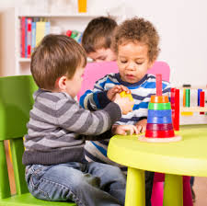
Overview
Unpacking the construct – Key dimensions of young children’s social-emotional growth and how these matter for learning across the curriculum
Implications for coursework, practicum, preparation for teacher leadership

Slide 3
What is social-emotional growth in children 0 to 8 years and how is it a foundation for learning?
Social emotional growth in young children = development of key social-emotional competencies
Emotion-regulation
Positive social behavior
Ability to interpret others’ behavior
Understanding emotions; emotion vocabulary
Capacity for positive relationships with adults and peers

Slide 4
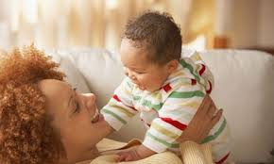
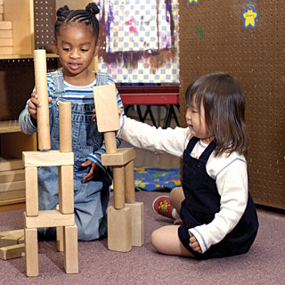
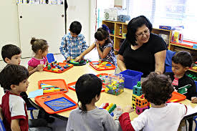
How do social-emotional competencies promote learning?
Social skills, self-regulation, capacity for a positive relationship

Slide 5
Adult-child and peer relationships
(O’Conner & McCartney, 2007; Nix, Bierman, Domitrovich, & Gill, 2013)
Positive adult-child and peer relationships
Children’s social-emotional skills
High engagement in learning and school achievement

Slide 6
Behavior/mental health problems in early childhood
Wide range of prevalence estimates in research literature, with higher rates for children in poverty – 17% to 29% (Qui & Kaiser, 2003; Holtz, Fox, & Meurer, 2014)
Early childhood behavior problems tend to persist (Blandon et al, 2010)
Early childhood mental health problems predict poor school outcomes (e.g., Denham et al., 2012; Bulotsky-Shearer and Fantuzzo, 2011)

Slide 7
Implications for ECE Coursework
A dedicated course on social-emotional teaching?
Young children’s social-emotional development in the context of relationships, culture, and diverse family circumstances
Classroom practices that promote a supportive teacher-child relationship and children’s social-emotional competencies
Parent engagement practices that promote a supportive teacher-parent relationship and nurturing home-based parent-child activities

Slide 8
Social-emotional teaching practices
Modeling positive social behavior
Helping children understand others’
behavior or emotions
Coaching child to use social skills
Helping child cope with frustration
Using emotion vocabulary and planning
(Hyson, Whittaker, & Zaslow et al., 2011)

Slide 9
Social-emotional curricula and evidence-based practices
“Consumer Reports” review of social emotional curricula at
Quality Center on Early Childhood Development, Teaching, and Learning at http://eclkc.ohs.acf.hhs.gov/hslc/tta-system/teaching/docs/curriculum-report-se.pdf
Early Care and Education Research Connections http://www.researchconnections.org/childcare/welcome
Head Start Cares Study found positive impacts on teaching and children’s social-emotional competence for two curricula – PATHS and Incredible Years (MDRC, 2015)

Slide 10
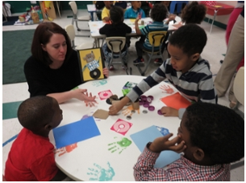
Social-emotional teaching methods across the curriculum
Integration of S-E teaching into courses covering other curriculum domains (e.g., language/literacy, early math) and in more general ECE curriculum courses
Increases dosage of S-E learning
Increases active engagement and learning

Slide 11
Parent Engagement
Promote parent engagement practices that support social-emotional competencies as part of routine parent-child activities
Parents need to see and practice new parent-child activities (Grindal et al., 2013)
Interactive Read Aloud
Talking about and labeling emotions
Helping children understand behavior
Reading with a nurturing style
(Landry et al., 2012)

Slide 12
Social-emotional teaching in the practicum
Research on professional development and coaching holds lessens for the design of an effective practicum
Coaching can be effective in improving teachers use of social-emotional teaching practices
Feedback on use of strategies is key (Zaslow et al. 2010; Stormont, 2015)

Slide 13
Social-emotional teaching in the practicum: key experiences
Practice and receive feedback on specific social-emotional teaching strategies
Practice and reflect on specific social-emotional teaching strategies
Observe and give feedback on specific social-emotional teaching strategies
Use social-emotional teaching strategies intentionally across the curriculum (read alouds, math activity, science center, transitions)

Slide 14
Strategies that support improvement in social-emotional teaching practices over time
Continuous Quality Improvement Practices
Practice and Reflection
Observation and Peer Coaching
Seeking Feedback
Working with Consultants

Slide 15
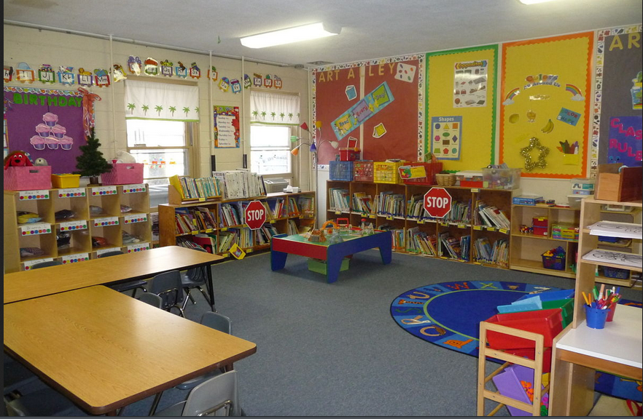
Knowledge about environment and routines
What supports S-E learning?
Low stress routines, engagement in activities that build S-E competencies (e.g., team or partner jobs)
What creates stress, triggers challenging behavior, and hinders social-emotional learning?
Long wait times, lack of developmentally appropriate materials, space not defined, lack of quiet space

Slide 16
Talk and reflect
What are the strengths of your current program in preparing teachers to promote young children’s social-emotional growth?
What are one or two ideas for strengthening your program’s capacity to prepare teachers to use effective social-emotional teaching practices and continuous quality improvement?

Slide 17
What future teachers should learn about teacher leadership and work supports
The early education field needs teacher leaders in many roles
In programs, as leaders in quality improvement
In the larger community, as leaders advocating for children, families, and work supports

Slide 18
Work supports matter to S-E teaching and learning
Relationship between teachers’ financial security and children’s positive emotional expression and behaviors (King et, 2015)
Job satisfaction and motivation toward professional growth related to teachers’ views that they have challenge, choice, and a sense of community in their work life (Hall-Kenyon; Bullough; MacKay; Marshall)

Slide 19
Evidence that wellness matters
Relationship between preservice teachers’ use of self-calming thoughts and supportive response to children’s negative emotions (Swartz & McElwain, 2012)
Relationship between workplace stress and conflict in teacher-child relationship (Whitaker, Dearth-Wesley,& Gooze, 2015)
Some studies have shown benefits of teacher stress reduction interventions (Zhai, Raver, & Li-Grining, 2011; Singh, 2013)

Slide 20
Supportive Environmental Quality Underlying Adult Learning (SEQUAL) – Five domains
Teaching Supports
Curriculum and Child Assessment, Materials, Support Services for Children and Families, Staffing
Learning Community
Professional Development Opportunities, Applying Learning
Job Crafting
Making Decisions in Your Classroom, Teamwork, Input into Your Workplace
Adult Well-Being
Economic Well-Being, Wellness Supports, Quality of Work Life
Program Leadership
Supervisor, Leader supportiveness (Source: http://www.irle.berkeley.edu/cscce/wp-content/uploads/2013/08/SEQUAL-1-Pager.pdf)

Slide 21
Thank you!
Sheila.Smith@nccp.org
National Center for Children in Poverty website: nccp.org
Early Care and Education Research Connections website:
www.researchconnections.org/childcare/welcome

