Slide 1
Gateways to Opportunity Higher Education Forum April 9, 2015
Cindy Zumwalt, Division Administrator
Early Childhood Division
Illinois State Board of Education

Slide 2
High Quality Early Childhood Education
Children Who Are Most At Risk
Birth to 3rd Grade Continuum

Slide 3
Ensuring High Quality Preschool Programs
Comprehensive Developmental Screening
Licensed Teacher with Early Childhood Education Endorsement
Standards-Aligned Research-Based Curriculum
Ongoing Authentic Assessment
Positive Adult Child Interactions
Intentional Teaching
Family Involvement and Education
Community Collaboration
Reflective Practice
Instructional Leaders

Slide 4
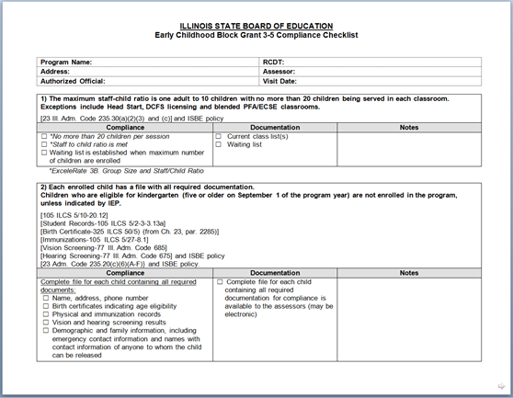
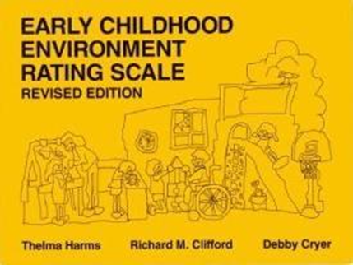
PFA Program Monitoring
Three year rotation
Two components to monitoring visit:
PFA Compliance Checklist
Early Childhood Environmental Rating Scale-Revised (ECERS)
One compliance report for the program and an ECERS report for each classroom visited

Slide 5
12) The program utilizes an appropriate assessment that aligns with the curriculum and documents children’s progress over time with measurable outcomes.
PFA Compliance Checklist Item #12 | FY 12 | FY 13 | FY 14
Research-based assessment tool used | 69% | 68% | 71%
Assessment includes ongoing regular observations | 71% | 74% | 87%
Portfolios are individualized | 29% | 32% | 30%
Portfolio collections do not reflect the IELDS | 46% | 52% | 57%
Narrative summary reports are used to share assessment information with parent/guardians | 62% | 61% | 52%

Slide 6
Assessment/Portfolios
Authentic samples that demonstrate progress or development over time
Samples reflect the Learning Standard intended to document
Observational notes detail the learning skill, describe what happened
Samples include interpretation of child’s learning
Use portfolio items to plan effective lesson plans and differentiate instruction for each child in the class
Portfolio samples are summarized in a narrative report

Slide 7
10) The program uses a research-based curriculum that aligns with the Illinois Early Learning and Development Standards.
PFA Compliance Checklist Item #10 | FY 12 | FY 13 | FY 14
Program has research-based curriculum | 62% | 71% | 98%
Curriculum aligned with IELDS | 65% | 72% | 97%
Lesson plans show connection with IELDS | 45% | 46% | 54%
Lesson plans individualized | NA | 14% | 21%

Slide 8
Curriculum
Comprehensive
Research based
Developmentally appropriate
Aligned with IELDS
Used with fidelity
Used in conjunction with an aligned authentic assessment system to individualize instruction

Slide 9
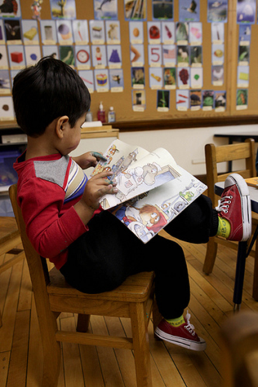
ECERS-R Language and Reasoning
Language and Reasoning Subscale Items | FY 12 | FY 13 | FY 14
Books and Pictures | 4.50 | 4.75 | 4.95
Encouraging children to communicate | 6.53 | 6.84 | 6.92
Using language to develop reasoning skills | 3.24 | 3.48 | 3.60
Informal use of language | 4.82 | 4.35 | 4.42

Slide 10
ECERS-R Language and Reasoning 2013-2014

Slide 11
Using Language to Develop Reasoning Skills
Talk with children about logical relationships
Concepts – Same/different, matching, classifying, sequencing, spatial relationships, cause and effect
To score higher than 4
Encourage children to talk through or explain their reasoning when solving problems
Encourage children to reason throughout the day using actual events and experiences
Concepts are introduced in response to children’s interest

Slide 12
Intentional Teaching
Heart Person
Person’s Heart

Slide 13
Serving Children who are Most-at-Risk
Address Early Gaps in Learning
Invest in Our Future Workforce

Slide 14
Comprehensive Services
Intensive parent engagement & education
Health/Mental health services
Nutrition services
Physical activity services
Services coordinated with LEAs and early intervention service providers
On-site coordination of services

Slide 15
Family Engagement Framework A Guide for Illinois School Districts, Schools and Families
Overall Purpose
Bring together research, best practices, and program requirements
Provide a resource for district/school leaders, and families to use in planning, implementing, and evaluating family engagement practices that directly improve student outcomes
Components
Family Engagement Framework Overview
Research Review
Family Engagement Standards
Integrating Family Engagement Matrix
Legislative Requirements/References
http://www.illinoisparents.org/

Slide 16
Birth through 3rd Grade Continuum
Illinois’ vision is to ensure continuity & intensity of services by building a Birth thru 3rd Grade pipeline for those children who are most at risk of school failure and other poor outcomes
Vertical
3rd Grade
2nd Grade
1st Grade
Kindergarten
Safe, Healthy, Ready to Succeed & Eager to Learn
Early Care & Education
Birth to 5 Years Old
Horizontal

Slide 17
Birth to 3rd Grade Alignment
Improve transitions for children and families and improve educational outcomes
Reduce “fade out” with a coherent set of high-quality learning experiences
Maximize impact of early childhood investments
Early Childhood
K
Early Elementary
Alignment Efforts Will Improve Transitions
Early Childhood K Early Elementary

Slide 18
To learn more about KIDS:
illinoiskids.org

Slide 19
Contact Information
Illinois State Board of Education
Early Childhood Division
http://www.isbe.net/earlychi/
earlychi@isbe.net
217-524-4835

Slide 20
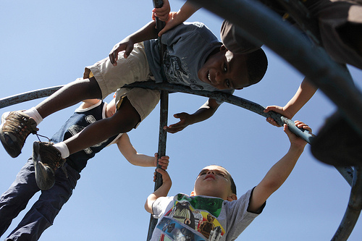
Q & A

