Slide 1
Is Fairness an Illinois Value? A Case Study in Educational Opportunity
Dr. James L. Applegate
Executive Director
Illinois Board of Higher Education

Slide 2
Where are we now?

Slide 3
Illinois Has Set An Audacious Goal
To increase the percentage of the Illinois workforce who hold high-quality college credentials to 60 percent by 2025.
Notes:
)

Slide 4
We Have Made Progress But Must Accelerate

Slide 5
Total number of undergraduate certificates (one-year and longer), associate’s degrees, and baccalaureate degrees awarded each year in Illinois compared to the annual number necessary to meet the goal of 60 X 2025.

Slide 6
Why Must We Succeed?
Notes:
CHOIR I KNOW

Slide 7
Two Illinois: Income Growth 1979-2007
Notes:
“Pulling Apart: A State by State Analysis of Income Trends” Center on Budet and Policy and Priorities and the Economic Policy Institute. TOP TEN

Slide 8
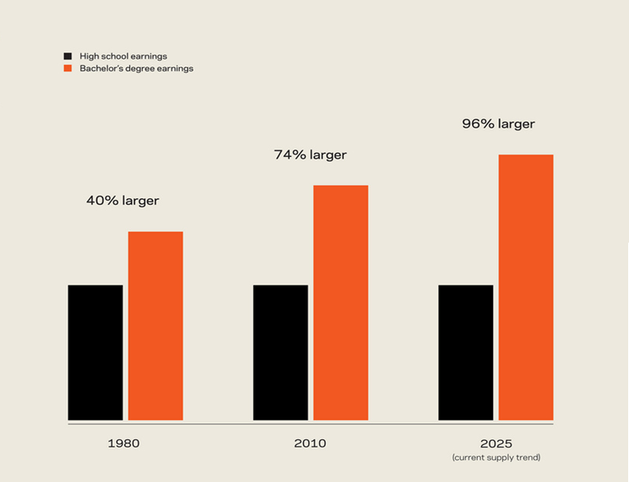
The Path to the Middle Class Leads Through College
Notes:
UPDATE 2013—DEPT OF LABOR 98% premium in 2013!

Slide 9
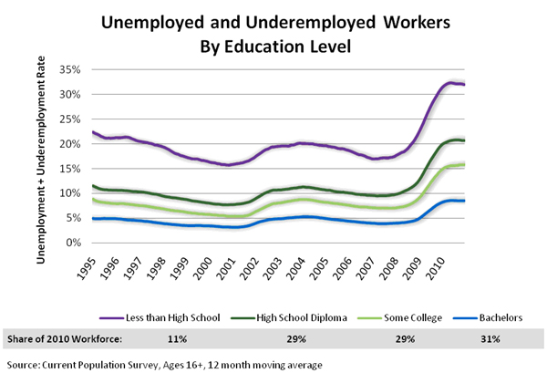
Drive the message Home: The Finish Line has Changed

Slide 10
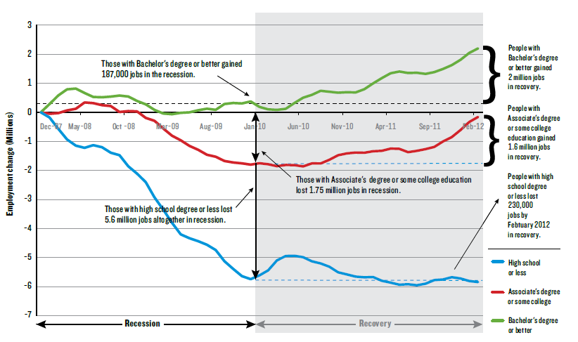
Our Workforce is Misaligned with Economic Needs

Slide 11
What Must We Do To Succeed With Adults?

Slide 12
Progress will require all of us to support increased state investment

Slide 13
Re-Commit To Fairness: Illinois’ Gaps are Growing
Notes:
HITTE SPACE = LOST TALENT
Adult completion = diversity issues

Slide 14
Create Affordable Pathways To Completion
Notes:
National but given IL in top ten per income inequality doubt different; little progress last five years PRODUCTIVITY, STATE REINVESTMENT, FINANCIAL AID,
AFFORDABILITY FOR MIDDLE/LOW IS AN ADULT ISSUE-THEY WILL COME By DEFINITION FROM LOWER PAID AREAS (NO DEGREES)

Slide 15
Diverging Paths, Lost Opportunity

Slide 16
Commit to Remodel our education System

Slide 17
Remodel the P-12 to College Connection
Implement universal high quality early childhood education for low income children
Create a culture of college going beginning in early education
Implement the new Illinois Learning Standards and Assessments widely and well
Create simpler and more transparent pathways to college beginning early grades
Notes:
STATE SUBSIDIZED DATING SERVICE

Slide 18
Focus on Partnership: Multi-Sector Regional Collaborations for Impact
Bring the right partners to the table
Set a common goal(s)
Use shared metrics to measure progress
Adopt a shared agenda (priorities)
Implement mutually reinforcing strategies/tactics
Maintain continuous communication/trust
Identify a backbone organization
Notes:
IT CAN’T JUST BE HIGHER EDUCATION’S RESPONSIBILITY
METRICS , CONTINUOUS IMPROVEMENT, STOP DOING WHAT ISN’T WORKING

Slide 19
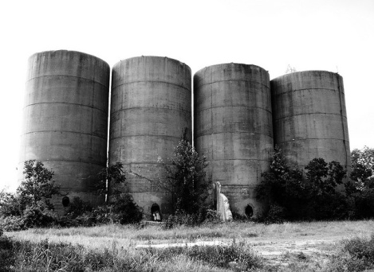
Tear Down Silos Between Education, Social Service and Workforce Programs
Create one stop services to integrate financial aid, TANF, SNAP, WIA, etc. financial supports for college
Create an asset map of programs that provide social/informational support to low wealth families and create an interagency model targeting support for postsecondary success

Slide 20
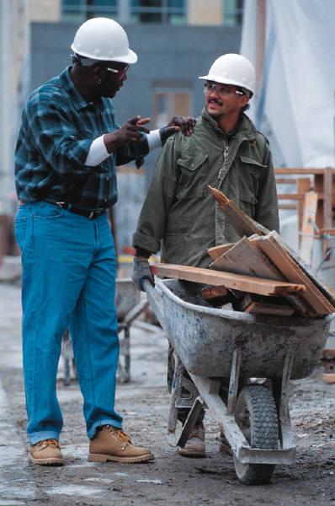

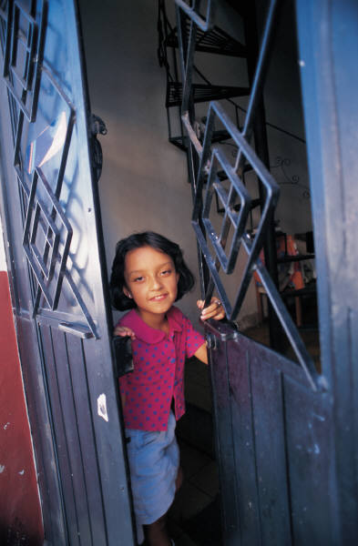
Focus On The Needs Of 21st Century Students
Of the 17.6M undergrads now enrolled 75% are juggling work, family, and school

Slide 21
Prepare EC Educators: Focus On Adult Learners In Illinois

Slide 22

Put Employer Skin in the Game
Make tuition reimbursement programs more strategic
Offer on and off site programs during working hours
Promote and reward education attainment internally
Partner in developing rigorous and relevant learning outcomes for degree programs

Slide 23
Create Adult Learner Focused Institutions (What’s It All About? ALFI!)
Target outreach strategies on the adult market
Expand life and career planning (pre-enrollment)
Create multiple, flexible financing plans
Create guided pathways tied to transparent workforce aligned learning outcomes (accelerate with PLA)
Use multiple methods of instruction (e.g. problem based, experiential) that emphasize relevance
Redesign student support systems
Use technology strategically
Create strategic partnerships

Slide 24

Remodel College to Career:
Completion for What?
Connect higher education and regional employment data: What is needed?
Engage employers in remodeling academic learning outcomes and degree production aligned with 21st century demands: Rigor and relevance
  Critical thinking/analytic skills
  Communication skills
  Literacy (including quantitative and digital literacy)
  Civic competencies
Notes:
ILDS:
HS FEEDBACK
CC FEEDBACK
MOST IMPORTANT CAREER FEEDBACK; TEXAS BIOLOGY/ENGLISH

Slide 25
It is NOT About Heroes and Miracles: It is About Us
Rediscovering the Spirit of American Progressive Movements
Notes:
Steven Johnson FUTURE PERFECT

Slide 26
THANK YOU!
Dr. James L. Applegate
Executive Director, Illinois Board of Higher Education
Email: applegate@ibhe.org
Blog: http://ibheillinois.blogspot.com/

