Slide 1
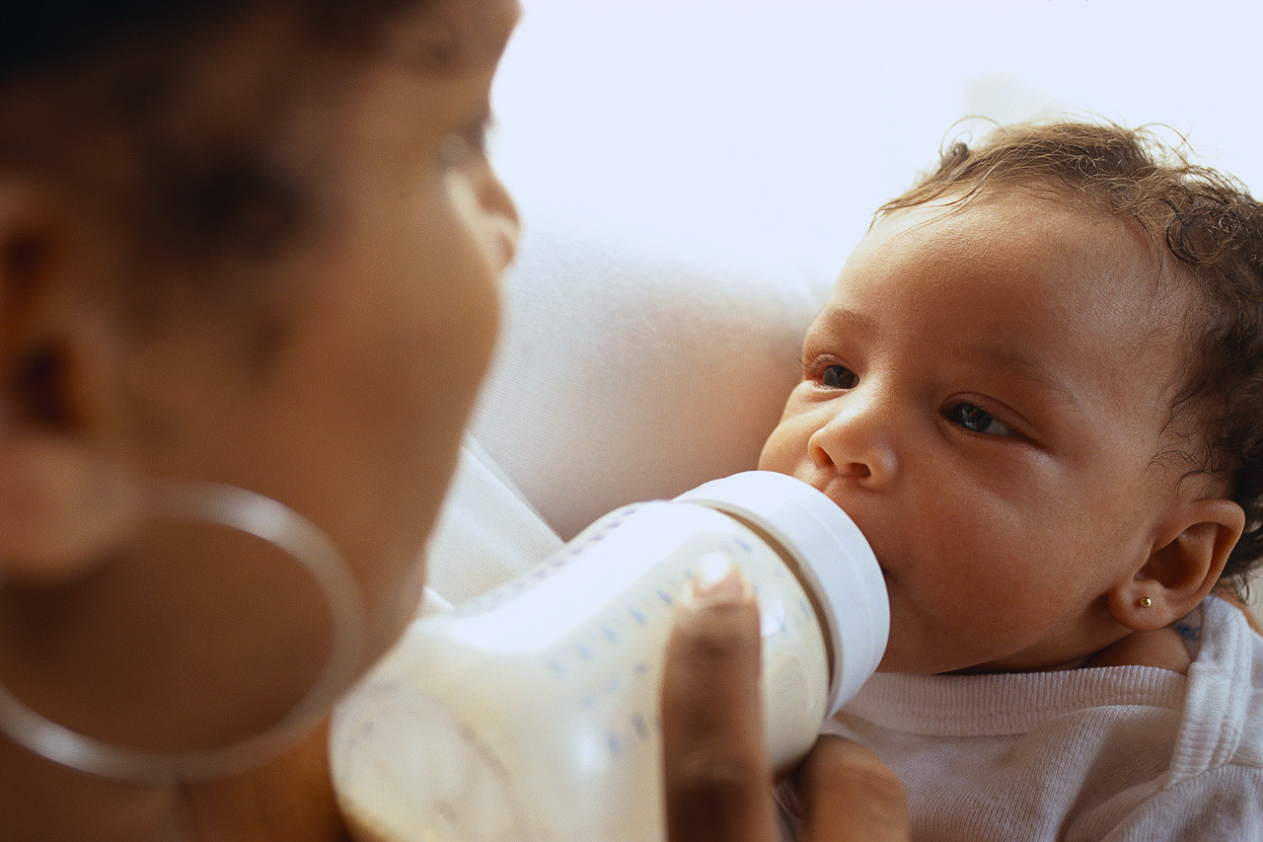
Supporting Infant/Early Childhood Professionals though Mental Health Consultation
Presented by: Linda Delimata
Date: 4/15/16
IL Children’s Mental Health Partnership
Governor’s Office of Early Childhood Development
Notes:
Have this slide showing as people come into the room.
Put your name and the date of the training in the space provided.
Introduce yourself. Let them know you are consultant through the IL Children’s Mental Health Partnership.
One focus of the work of the Partnership is providing mental health consultation to agencies that touch the lives of young children. There are so many areas of development for babies and young children that affect their growth and their lives. Social and emotional development is essential to success in life, and starts as early as pre-birth.
We hope that today shares a little information on the concept of Infant Mental Health, and that it is helpful to you in your world.

Slide 2
Welcome!
Introduction
Why include mental health preparation for infant/early childhood professionals?
Notes:
Ask each participant to stand up one at a time. Ask them to introduce themselves by first names.
Mingles and Huddles:
We will do 3 groups where we talk to 3 or 4 people about a question. You will have 2 minutes to talk to those people. When you receive a signal from me, then finish your last sentence, and raise your hand as well. When we are all quiet, we will ask you to find another group of 3 or 4 people that you have not yet spent time with discussing this question. We will repeat that same procedure, and then group one last time for a final reflection on the question, and then return to your seats.
Question: What frustrates me in my job?
After they finish the mingles and huddles, they return to their seat and you process the questions with them.
How was this for you?
What did you find you had in common with others in the room?
Did you hear any general themes?

Slide 3
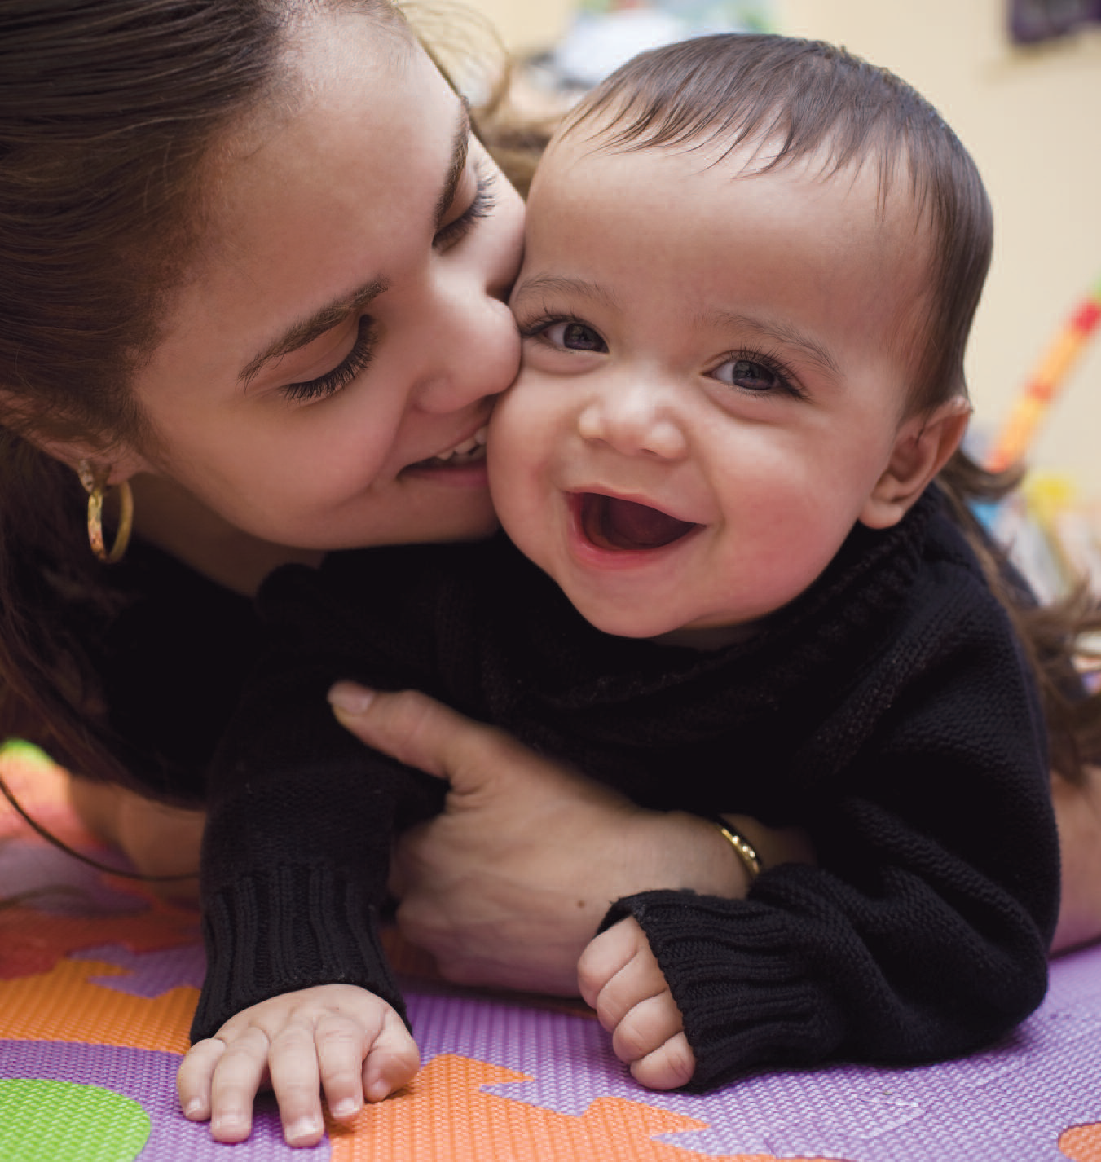
Increase your effectiveness to help babies, young children, and their families enjoy positive mental health.
Notes:
Acknowledge the role of home visiting and child care in helping children develop. Express our gratitude for the work they are doing, and our respect. Thank them for taking time to come to our training today, and let them know that our long range goal is to add to their already existing skills by providing them some support and a place to reflect on the work so they can help families enjoy positive mental health.

Slide 4
WHAT IS INFANT AND EARLY CHILDHOOD MENTAL HEALTH?

Slide 5
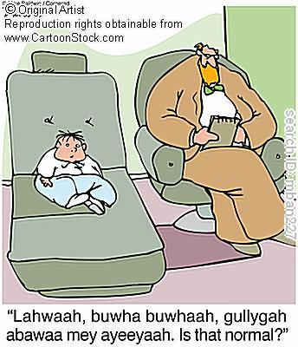
Infant Mental Health
Here is what it’s not:

Slide 6
Definition of Infant Mental Health
Infant Mental Health is:
The developing capacity of the infant and toddler to…
Form close and secure relationships.
Experience, regulate, and express emotions.
Explore the environment and learn.
…all in the context of family, community, and cultural expectations for young children.
(Zero to Three Infant Mental Health Task Force).
Notes:
This is really what early development is all about: learning how to communicate with and trust parents/caregivers; learning to manage an array of emotions with the help of those parents/caregivers; and learning about the world in which we live using sensory and cognitive skills

Slide 7
What is Infant/Early Childhood mental Health Consultation?
Early childhood mental health consultation involves a professional consultant … working collaboratively with early care and education staff, programs and families to improve their ability to prevent, identify, and respond to mental health issues among children in their care.
Georgetown University

Slide 8
The Focus of Infant and Early Childhood Mental Health Consultation
Always relationship based
Always striving to keep the whole family system in mind: the child, parents, and the context in which they live
Always strength based
Always individualized
Always striving to be continuous and stable
Always striving to be culturally responsive
Always stressing the importance of being self-aware, reflective, and being open to professional growth through reflective supervision and consultation
Notes:
All of this adds up to a field of work that is complex and demanding and always in a dynamic state of flux and change. Support for those who do this work is essential on all levels.

Slide 9
IECMHC
IECMHC offers an indirect approach to reducing problem behaviors in young children and, more broadly, promoting positive social and emotional development.
Georgetown University

Slide 10
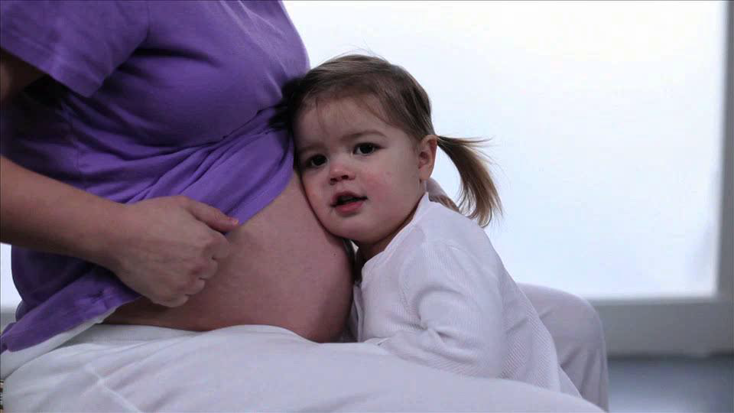
Experiences Build Brain Architecture
Notes:
The interactions children have build their brain, and affect their mental health.
10

Slide 11
All Experiences build the brain
Interactions are how children grow and learn
Some interactions develop skills to cope
Traumatic experiences hinder learning and brain development

Slide 12
Video from Harvard Center on the Developing Child
Jack Shonkoff presents information on brain development.
http://wn.com/the_science_of_early_childhood

Slide 13
What is Trauma?
Trauma is defined as a physical or psychological threat or assault to a child’s physical integrity, sense of self, safety or survival or to the physical safety of another person significant to the child.
(VT CUPS Handbook)

Slide 14
How does toxic stress affect children?
Prolonged stress can change physical, cognitive and social/emotional development.
Notes:
Results in a cascade of hormones
Increased cortisol levels
Impaired memory capacity
Shearing of dendritic connections: toxic stress actually destroys brain growth that has already been laid down/occurred
Epigenetic changes: changes in gene expression brought on by unrelieved stress: toxic stress can actually change the way genes do their work, increasing or decreasing their activity

Slide 15
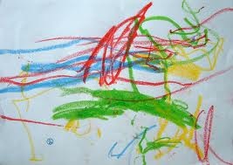
Some Effects OF TRAUMA
Behavioral Control and Regulation:
Major reactions to small events
Difficulty with transitions
Clingy/Dependent v. Standoffish/Distant
Poor boundaries
Acting Controlling
Fears, Nightmares
Impulsivity/Risk Taking/Self-destructive acts
Aggression

Slide 16
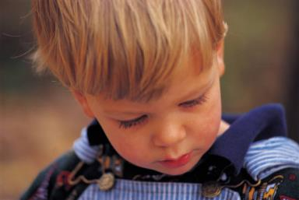
Effects OF TRAUMA CONTINUED
Traumatized children can have difficulty focusing on and completing tasks
Traumatized children frequently suffer from low self-esteem, shame, and guilt
Notes:
Cognitive: Traumatized children can have difficulty focusing on and completing tasks
The stress response system of traumatized children is always active and those chemicals/hormones interfere with the process of taking in new information and learning
Self-Concept: Traumatized children frequently suffer from disturbed body images, low self-esteem, shame, and guilt

Slide 17
Effects of trauma
Traumatized children may exhibit unexplained physical symptoms and increased medical problems.
Children exposed to trauma can have difficulty regulating their emotions
Some traumatized children experience a feeling of detachment, as if they are “observing” something happening to them that is unreal.
Notes:
Biology: Traumatized children may exhibit unexplained physical symptoms and increased medical problems.
Emotional Regulation: Children exposed to trauma can have difficulty regulating their emotions as well as difficulty knowing and describing their feelings and internal states
Dissociation: Some traumatized children experience a feeling of detachment, as if they are “observing” something happening to them that is unreal.

Slide 18
Look Through Their Eyes
A resource to assist with understanding the effects of trauma and to become more informed on ways to address the issues.
www.lookthroughtheireyes.org

Slide 19
Table Discussions
How would the traumatic effects identified impact early childhood educators/providers?
How do you see infant/early childhood mental health consultation helping the staff?
What might you add to your curriculum to help prepare the workforce?

Slide 20
Benefits of IECMHC
Provides a place to reflect on cases
Offers support with difficult issues
Builds skills to help address mental health concerns
Promotes reflection in supervision and group work
Supports and encourages relationships

Slide 21
Reflective Practice
Reflecting practice involves stopping and examining the work that one is doing, “stepping back from the immediate experience to become aware of and sort through thoughts and feelings about what one is observing and doing with children and their parents.”
(Shahmoon-Shanook, Gilkerson, Eggbeer & Fenichel, 1995)
From ICMHP Reflective Practice Guide, p. 15, Peggy North Jones

Slide 22
Self-Knowledge
Working within the field of IECMH requires managing and balancing the complex array of infant/child and parent needs with one’s own professional and personal reactions to those needs.
Meeting this goal requires engaging in a process of self-exploration.
Participating in reflective consultation and supervision supports the process of self-exploration and leads to increased self-awareness.
The result is an increased capacity to “catch one’s self” and control one’s professional responses in challenging situations.
Notes:
Recognizing how significant the wish to rescue or solve problems for families is within ourselves can help to reduce the stress and anxiety of working with families who have complex and pressing needs. Humility and manageable goals are one positive outcome of engaging in a reflective process.

Slide 23
The Parallel Process
The relationship which the staff establishes with the mother/family/baby helps to hold, contain, and regulate the family.
Reflective Supervision and Consultation help to hold, contain, and regulate the staff, supervisor, and other program personnel.
Self-Awareness supports the essential process of Self-Regulation.
Notes:
Providing a holding environment for families can take its toll in stress for FSWs – and anyone else working with the families. Everyone benefits from everyone having an opportunity to think about and share the feelings and thoughts that emerge from this work.

Slide 24
Use of Self in Reflective Practice
Work with families can evoke past or present personal experiences, both in the staff and in the family, on a conscious or unconscious level
The staff’s personal characteristics, style, and role influence the work with families through conscious and unconscious means.
Notes:
It is the process of becoming self-reflective that makes it possible to monitor the role that our unconscious thoughts, feelings, attitudes,, and memories play in relationships with clients, including how we present ourselves, how we respond to how clients present themselves, and what they tell us about themselves. Just as we note that parents can struggle with who their babies remind them of because of physical appearance or behavior, we can struggle with who clients remind us of, whether someone from our professional or personal lives.

Slide 25
Some Funders in IL Currently Provide for I/ECMHC
Early Intervention
Head Start
Some ISBE programs
Caregiver Connections (DHS)
Preschool for All

Slide 26
Illinois Plans for Consultation Model
Pulling together state departments that fund infant/early childhood services
Public and private funders
Leadership team objectives
Model development team objectives
Plan for future pilot
Evaluation

Slide 27
Video from National Work
The website is a professional development tool that was recently designed for infant and early childhood mental health consultants
https://eclkc.ohs.acf.hhs.gov/hslc/tta-system/health/mental-health/ec-mental-health-consultation/mh-consultation-tool

Slide 28
National Work on Consultation
Table discussion questions:
What experiences have I had with I/ECMHC?
What are we currently doing to prepare the workforce for understanding behavior and mental health challenges?
How would consultation support the workforce?
What other information do I need?

Slide 29
Questions and Reflections
"Let us put our minds together and see what kind of life we can build for our children"
~Sitting Bull~

Slide 30
The future of prevention in working with infants and early childhood includes reflective consultation…. Time to get on board.
THE END

