Slide 1
Tandem Preparation of Early Childhood Education Teachers
Building Partnerships Within the Field
2016 Illinois Higher Education Forum
Melissa Szymczak, Associate Professor
Joliet Junior College
mszymcza@jjc.edu

Slide 2
Session Objectives
Analyze and describe opportunities to integrate enhanced Student Competency Feedback into course sequences
Prepare for successful internships/ student teaching
Improve quality of field experiences by creating realistic supervising teacher responsibilities with limited resources

Slide 3
Notes:
Poll Title: Please reply to the "Poll Everywhere" survey choosing those statements below you agree are true for your program. https://www.polleverywhere.com/multiple_choice_polls/dZkvNh8jYOHpsac

Slide 4
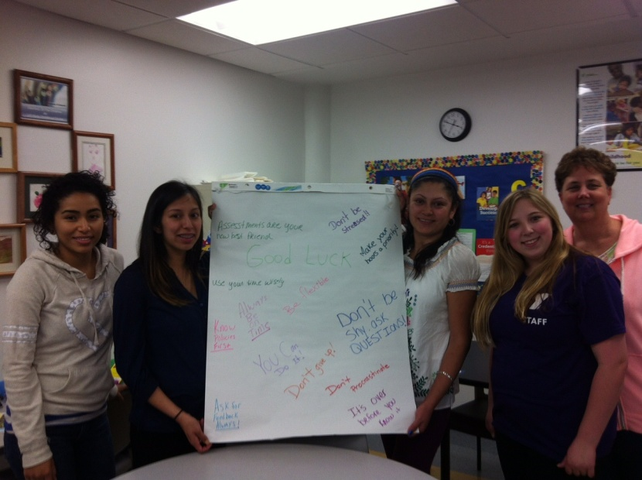
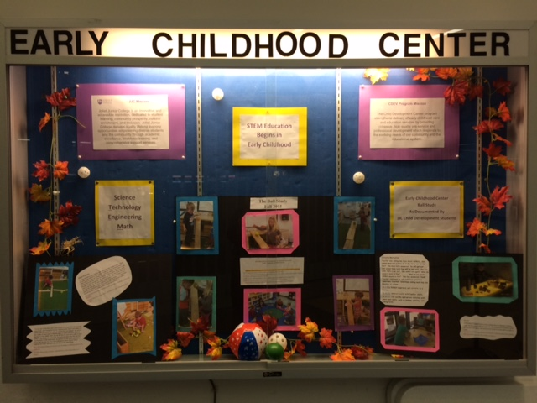
Joliet Junior College
The mission of the JJC Child Development Career program is to strengthen delivery of early childhood care and education services by providing cohesive, high quality pre-service and professional development which responds to the evolving needs of our community and the educational system.

Slide 5
JJC CDEV Enrollment

Slide 6
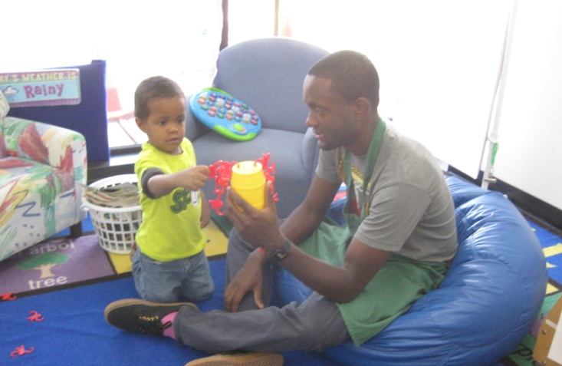
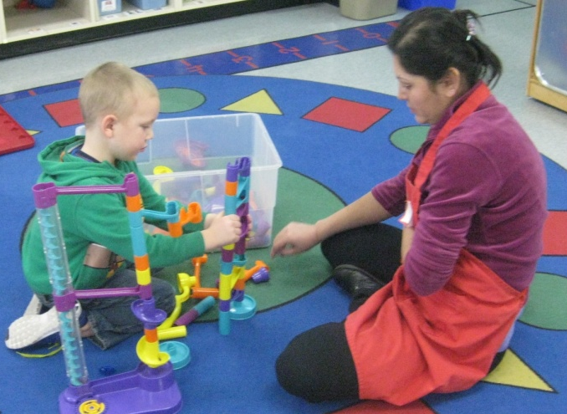
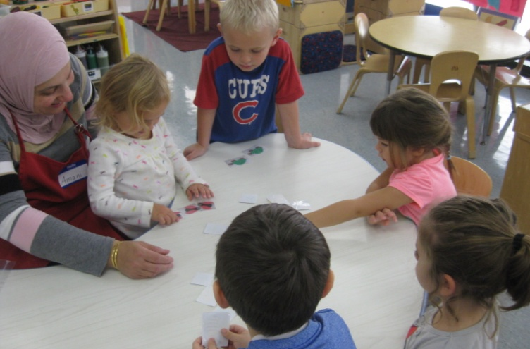
Joliet Junior College
Early Childhood Center
NAEYC Accredited Program Serving up to 40 children
ages 3-5 years

Slide 7
Barriers and Threats
How do we communicate the benefits of well prepared ECE and CDEV graduates to our communities?
How do we explain the value of field experiences, observations, and teacher practice to graduate competencies?
WHO needs to hear this message?

Slide 8
Improvement Foci
Student – Graduate Competency
Building Partnerships
Shared Responsibility

Slide 9
Shared Responsibility Mindset
Joliet Junior College offers 63 AAS degrees under Career and Technical Education.
Of those degrees, at least 31 have a lab presence on campus.
CDEV AAS graduates have completed a minimum of 65 observation and 140 field experience hours, at multiple sites within the community.

Slide 10
Teacher Preparation Partnerships
Student
Faculty
Community Programs and Schools
College Staff Statewide Programs Administrators

Slide 11
Student- Graduate Competency
What challenges have you faced, specifically in your internships and student teaching, that have hindered the program’s desired levels of graduate competency?

Slide 12
Student- Graduate Competency
JJC program analysis indicates students would benefit from increased teaching practice in ECE settings prior to the internship/ capstone course.
Internship evaluations
Feedback from cooperating teachers
Student surveys and self reports
In class/ lab observations

Slide 13
CDEV Program Improvement Tasks
Competency/ Curriculum Mapping
Teaching Experience Feedback Forms
Faculty Observation (day classes)
Student Peer Observations Reviews

Slide 14
Curriculum Mapping Courses
CDEV 101
Intro to CDEV
20 hours of Observation and Field Experience
CDEV 220
Instructional Methods
5 hours of Field Experience
CDEV 255 Internship
130 hours of Field Experience

Slide 15
Teaching Experience Feedback
Using a consistent rating form for all three courses, so the student can see growth
Identified non-threatening teacher behaviors that would be easier to adapt
Asking student to receive this feedback from both community and on campus lab teachers

Slide 16
Faculty Observation
Rating scale form based on Internship outcomes was performed in the Instructional Methods course
Students received one on one mentoring/coaching from Christie Easley, Adjunct Instructor, and a Doctoral student at Concordia University

Slide 17
Student Peer Review
Students create and lead a math lesson with preschoolers during class, which is observed by their peers through one way windows.
Peers complete a supportive review as they observe.

Slide 18
Student Graduate Competency
“I can see what my strengths are when interacting with a child and how to meet their needs.” CDEV 101 Student
“After reading my peer reviews, I learned I need to ask more open ended questions. I will definitely work on this as I continue my development.” Instructional Methods Student
“I feel we should have more experience hours put into the course to be able to try and apply the knowledge we have learned.” CDEV 101 Student

Slide 19
Cooperating Teacher Mentors
There are limited options for students to utilize in my area
How have you addressed this challenge?
Do you think it is a benefit that sites are utilized repeatedly? Why or why not?
There are many facilities in proximity of my college
Have you made agreements for your student’s field experiences with any in particular?
What challenges are you facing?
What challenges are you facing?
I have an on campus child care or lab school.
Are students required to complete hours of experience at this site?
To what extent have the degree program and on campus ECE site partnered? What are the challenges?

Slide 20
Next Steps
EPPI grant work to improve cooperating teacher mentoring effectiveness
Partnering to increase and diversify child enrollment at on campus EC program
Completing Employer surveys as part of Annual Program Plan
Pathways to Completion Plan- field experiences in ECE courses of High schools

Slide 21
Preparing Exceptional Teachers
“Although we did learn a lot in class during the reading and power point, I know I personally benefitted by working hands on with the children. I would not have understood how to implement this method within my own classroom without practicing it first within the ECE classroom with real children. Overall, the teaching practices during the semester within this class has only helped me gain, not only my understanding, but also my confidence as a teacher and adult.”-
Instructional Methods Student Fall 2015

Slide 22
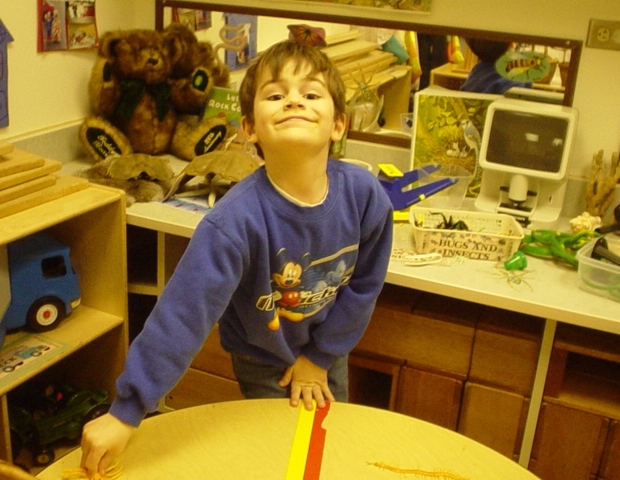
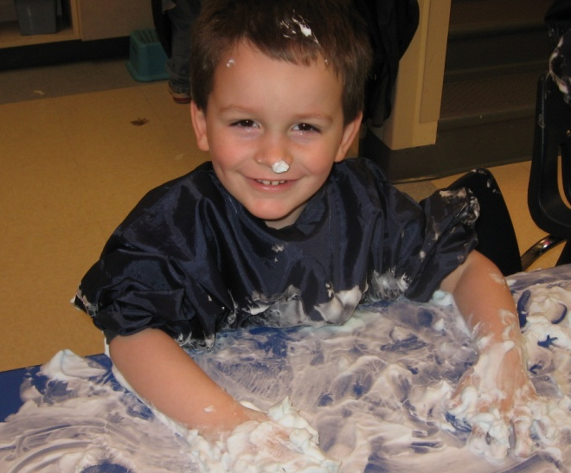
Many thanks to the JJC CDEV and EDUC students, and the children and staff of the JJC Early Childhood Center

